Slide 2
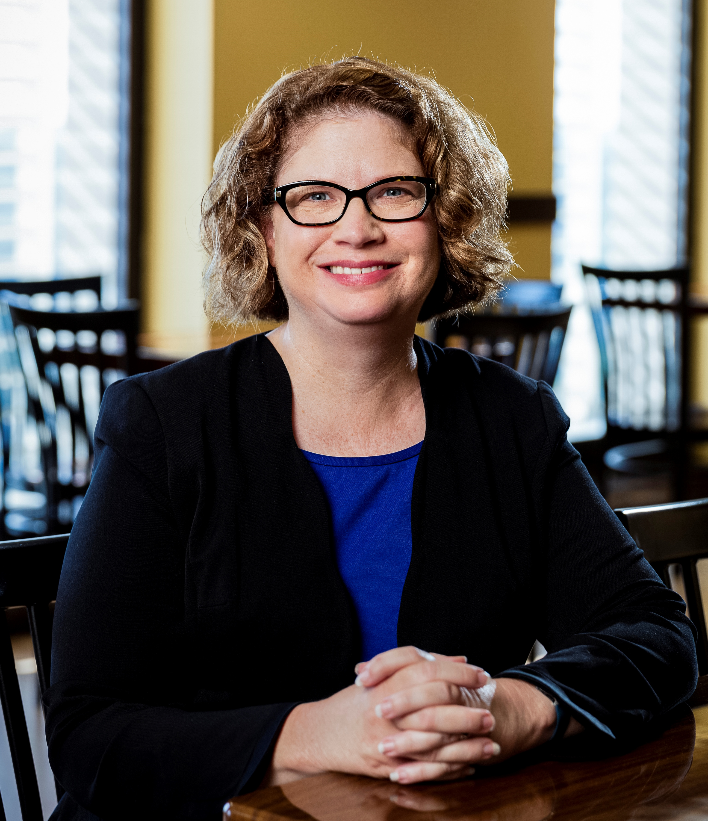
ABLE United
Florida’s Qualified ABLE Program
Jenn Sikora, ABLE United Brand Ambassador
Notes:
Thank you for coming today to learn more about ABLE United, Florida’s qualified ABLE program.
What follows is a high-level overview of ABLE United, who it’s for, how it works, and it’s benefits. I’ll also be sure to leave time for questions at the end.

Slide 3

ABLE Accounts
Notes:
Let’s begin first with an overview on ABLE accounts.

Slide 4
What can ABLE United do for you?
Save like never before.
Save while maintaining federal benefits
Save with the help from family and friends
Save tax-free for future expenses
Various investment options including a FDIC-insured savings fund to give you peace of mind
Gifting page to allow others to support you in reaching your savings goals
Administered by the state of Florida, managed under the Florida Prepaid College Board
4
Notes:
So, what exactly is an ABLE account?
It’s a tax-free investment account established to support qualified disability expenses all while maintaining government benefits
Benefits we will discuss include:
We’ll discuss how you can still maintain government benefits
Save with help from family and friends (anyone can contribute into an account).
Save tax-free. Gains on account will not be subject to tax as long as expenses are qualified, which we will cover in greater detail in just a moment.
We’ll also go over some new features, since ABLE United recently transitioned to a new records administrator in March 2019, including:
A new, FDIC-insured savings options for peace of mind
As well as an updated gifting page to make it even easier for loved ones to help you reach your savings goals

Slide 5
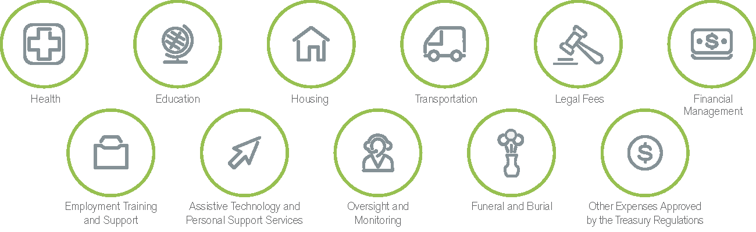
Why an ABLE Account?
To help maintain or improve health, independence or a quality of life
Qualified disability expenses, which include “living expenses,” are not required to be medically necessary or to be limited for the sole benefit of the individual with a disability.
5
Notes:
Through an ABLE account, you are able to save funds for future qualified disability expenses. These include:
Basic living expenses
Not medically necessary or limited to sole benefit of the individual with the disability
Include everything you see here, such as health, housing, education and transportation
It’s important to note that SSA states that expenses like gambling or giving funds away would not be qualified disability expenses.
If an expense is not a qualified disability expense, the funds spent are subject to tax plus a 10 percent penalty on the earnings.
One example we like to give is when an individual may need assistance with navigation, for which a cell phone is useful. That could be considered a qualified disability expense by the Treasury.
We often receive questions on who makes the determination if an expense is qualified or not. The individual or the person who administratively responsible for the account would need to keep necessary documentation so that if the IRS or social security asked, they could show that the expense relates to the person’s disability and helps improve their health, independence or quality of life. Please note that the IRS has stated that the expenses categories should be construed broadly.

Slide 6
How ABLE Works with Government Benefits
Supplemental Security Income – Some additional rules
Medicaid – Not counted as a resource
Other Federal Programs – Not counted as a resource
6
Notes:
Let’s shift to talking more about how you can save with ABLE United and not jeopardize government benefits.
The first is SSI, which will be explained in more detail on the next slide.
The second is Medicaid, which has a $2,000 resource limit (this means the amount of cash someone can have on hand).
ABLE accounts do not count towards that resource limit. This include all Medicaid type programs including Medicaid Waiver Services provided by APD.
The third are Other Federal Programs, which do not count these funds as resources including: Supplemental Nutrition Assistance Programs (SNAP), FAFSA application, or HUD.

Slide 7
What if I am Receiving SSI?
Save for the future without losing Supplemental Security Income.
Generally, funds in (or withdrawn from) an ABLE account are disregarded when determining eligibility for Supplemental Security Income (SSI).
The first $100,000 in an ABLE account does not count as a resource.
All housing and non-qualified expenses withdrawn, but not spent, in the same month count as a resource.
For more information, visit the Social Security POMS website at: https://secure.ssa.gov/apps10/poms.nsf/lnx/0501130740
7
Notes:
Like Medicaid, SSI has a resource limit of $2,000. An ABLE United account allows individuals receiving SSI to save above and beyond this limit.
Generally, funds in (or withdrawn from) an ABLE account are disregarded when determining eligibility for SSI.
Up to $100,000 saved in an ABLE account does not count as a resource.
However, housing and non-qualified disability expenses withdrawn but not spent in the same month count as a resource.
For example, Amy takes a distribution of $500 from her ABLE account in May to pay her rent for June. She deposits the $500 into her checking account in May, withdraws $500 in cash on June 3, and pays her landlord. This distribution is a housing-related QDE and part of her checking account balance as of June 1, which makes it a countable resource for the month of June.
You can have the ABLE account pay your housing expenses directly and you don’t have to worry about it impacting your SSI benefits.
The social security administration has a program operations manual system, also known as POMS, that they use to describe how social security should handle ABLE accounts when it comes to those individuals receiving SSI. We’ve included a link here to access POMS.

Slide 8
What if individual is receiving Medicaid?
Save for the future without losing Medicaid.
Funds in (or withdrawn from) an ABLE account are disregarded when determining eligibility for Medicaid.
Generally, after all outstanding qualified disability expenses have been paid, leftover funds would go to the beneficiary’s estate.
Recent Florida law states Medicaid may not file a claim on an ABLE account.
Death of Beneficiary form available on website
8
Notes:
One of the biggest benefits of ABLE United is that you can save without negatively impacting federal benefits.
Funds in or withdrawn from an ABLE account are disregarded when determining eligibility for Medicaid, so you can continue receiving Medicaid AND save in your ABLE United account.
One thing to note is that federal law allows for a state to file a claim for Medicaid expenditures from an ABLE United account when a beneficiary passed away. This year, Florida joined California, Maryland, Pennsylvania, and Oregon in passing legislation to clarify that all outstanding funds in an ABLE United account, after Qualified Disability Expenses are paid, go to the beneficiary’s estate. Simply put, ABLE United account owners will no longer be treated differently than any other individual who receives Medicaid. We are so excited about this!

Slide 9
Who Can Open an Account?
Notes:
Now that we’ve talked about some of the key benefits of ABLE United, let’s discuss who can open an account.

Slide 10
ABLE United Eligibility
What is required to open an account?
Eligible individuals are allowed one ABLE account nationwide and must also:
Be a Florida resident
Have a disability with onset prior to age 26
Have a disability that is “severe”
If an individual is not receiving SSI or SSDI, then self-certify is an option, and that individual must:
Have a diagnosis of a physical or mental impairment prior to age 26
Be “marked and severe with functional limitations”
Be expected to last for at least 12 months
10
Notes:
Most importantly, you can only have one ABLE account nationwide.
There are three eligibility requirements for ABLE United.
First, the individual with a disability must be a Florida Resident. Simply put, they have to live and treat Florida as their permanent home. Residency is only a requirement when enrolling. Once a person has enrolled they can move out of the state and still keep their ABLE account. At this time there is no documentation required to confirm an individuals residency status.
The next two requirements are true for ALL ABLE programs as prescribed in the internal revenue code. First the individual’s disability had to have an onset prior to age 26, Which basically means that the disability was diagnosed as having occurred prior to age 26. And second, the disability has to be severe. But, what does it mean?
A qualifying disability means an individual who is entitled to benefits based on blindness or disability under Title 2 (Social Security Disability Insurance which is an earned program based on work history) or Title 16 of the Social Security Act (Supplemental Security Income).
If an individual with a disability is not currently receiving one of these benefits, they must meet the ‘‘marked and severe functional limitations’’ standard of disability in the Social Security Act for children claiming benefits under the Supplemental Security Income program, but without regard to the age of the individual. Additionally this disability is expected to last at least 12 months, or result in death.

Slide 11
Ownership
The individual with a disability is the owner of the ABLE account.
Another person may assist in opening or maintaining the ABLE account (e.g., parent, legal guardian, power of attorney, etc.) When opening an account, they must have:
  Proof of authority (if other than a parent of a minor)
All paperwork can be accessed through secure our website with the intent of opening an account for the benefit of the individual with a disability.
11
Notes:
Unlike some other savings and investment options, the individual with the disability is the owner of the ABLE account
An important note is that another person can provide assistance in opening and/or maintaining the, account, such as:
Parent
Legal guardian
Power of attorney
Although the account can be maintained by someone else, the funds are to primarily benefit individual with disability to improve health, independence, and quality of life.
ABLE United accounts are opened and managed exclusively online – you don’t go to a bank. For those of you familiar with Florida Prepaid, it may help to know that ABLE United is managed by the Florida Prepaid College Board, and account management occurs in a very similar fashion.

Slide 12

How it Works
Notes:
So, once you’ve opened an account, how does it work?

Slide 13
Enroll
Open an ABLE account at ableunited.com
Here’s what you’ll need to open an account:
The date of birth, address and Social Security Number for the individuals (beneficiary and/or account administrator) on the account
Documentation of Power of Attorney or Legal Guardianship for an adult beneficiary (if applicable)
Banking information and a minimum $25 contribution to the account
Investment selections
13
Notes:
You’ll enroll online and signing up for an account takes 30 minutes or less
Here’s what you’ll need to open an account:
The date of birth, address and Social Security Number for the people on the account
Documentation of Power of Attorney or Legal Guardianship for an adult beneficiary (if applicable)
Banking information and a minimum $25 contribution to the account
Investment selections, which we’ll talk more about in just a moment

Slide 14
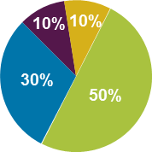
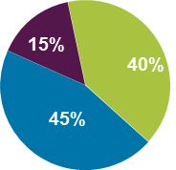
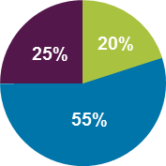
Select Investments
Choose as time of contribution, change invested funds twice a year.
Three predesigned portfolios to meet the needs of most investors or five individual funds to build a custom portfolio for those with more investment experience:
Portfolio Options
Conservative
Moderate
Growth
Funds
FDIC Savings Fund BNY Mellon
Money Market Fund Florida Prime
U.S. Stock Fund Vanguard
U.S. Bond Fund Vanguard
International Stock Fund Black Rock
14
Notes:
ABLE United offers seven investment options, ranging from conservative to aggressive, including three predesigned portfolio options, which you see here.
We also have the following:
Money market fund = Florida Prime (Local Government Surplus Funds Trust Fund) managed by federated investors
U.S. Bond Fund and U.S. Stock fund managed by Vanguard
International managed by BlackRock.
And, our newest offering is the FDIC Savings option, which is managed by the Bank of New York (and has no annual fee)
A few things of note here is that the interest earned on the FDIC Savings Fund will be credited by the Bank on the last business day of each month based
Interest varies depending on Federal Funds target rate
But most importantly, it usually slightly higher returns then a typical savings account
You can change how incoming contributions are invested at anytime and as frequent as you want. However, funds already invested in the program can only be rebalanced, or reinvested, twice a year.
Performance information is available on ableunited.com.
Two things we also recommend is to spend time and determine your financial goals and how you plan on using the account, as well as speak to a financial or legal professional about your situation.

Slide 15
Contribute
Anyone can contribute to the account.
Generally, contributions are considered gifts (not income) to the individual with a disability. Contribution considerations include:
A total of $15,000 can be contribution per calendar year
ABLE to Work allows working beneficiary not saving for retirement the ability to contribute above $15,000
Opportunity to rollover funds from 529 college savings plan
No federal income tax-deduction
Individual putting earned income into account, still counts as earned income
15
Notes:
After an account is open, an individual, their friends and family, or even an organization such as a church, can contribute to their ABLE account electronically – up to $15,000 from all sources, per calendar year.
There is one exception – and that is if an individual is working. ABLE to Work legislation allows beneficiaries who are working and not currently saving for retirement to contribute above $15,000, up to $27,490).
We also recently implemented rollover funds from 529 savings plans. At this time, you can’t do a direct rollover from a different type of tax-advantage saving plan like a Roth IRA or 401k.
Lastly, there is no federal income tax-deduction for contributing to an ABLE account, so you can’t write contributions to your ABLE account off as a donation. Contributions are considered completed gifts and not income to the individual. Unless the individual is putting in their earned income or if it some kind of unearned income like child support.

Slide 16

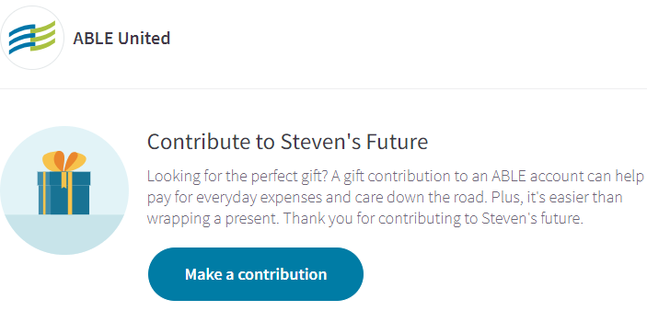
Contribute
Anyone can contribute to the account.
16
Notes:
As I mentioned, it’s easy to save with the help of friends and family, especially now that we have enhanced our gifting page.

Slide 17
Withdraw
Money may be withdrawn for any reason – you are in control!
All withdrawals must be made by electronic transfer (a written request is required for a check withdrawal). Earnings are tax-free if withdrawals are used for qualified disability expenses.
Choose which investment to withdrawal from – allows to separate savings from investing
Other considerations include:
Keep documentation for the IRS
SSA may evaluate the use of a withdrawal for SSI recipients
17
Notes:
I always say one of the best things about having an ABLE United account is its flexibility – money can be withdrawn from an account at any time, for any reason. Withdrawals may be made electronically or by check.
One important note is to keep documentation of expenses for the IRS. ABLE United won’t ask for documentation, but ABLE United will submit to the IRS yearly form 1099-QA that lists the account number, gross distribution, earnings, and contributions. Also a form 5498-QA will be submitted annually that states cumulative contributions, current account balance, basis of eligibility and disability type.

Slide 18
How Much Does it Cost?
No cost to open and maintain an account.
ABLE United offers the best value for Florida residents as there are no fees associated with opening an account:
No application fee
No monthly account maintenance fee
$25 minimum contribution
Annual fee of $10 for paper (OPTIONAL)
Investment administration fee ranges from 0.00% to 0.290% (annualized) of the account balance
  FDIC investment option has no fees
18
Notes:
I often get asked how much it costs to open an account – and the answer is that it’s free.
There is no:
Application fee
Account maintenance fee
All you’ll need to put in a minimum contribution of $25 to get started
I will note that there are small investment administration fees. But, the way to look at this is that the most you’d spend is less than $3 per $1,000 in the account annually. So if you maxed out your account at $15,000, you’re still paying less than $45 per year.

Slide 19
Common Questions about ABLE
Who owns the ABLE United account?
The beneficiary, the individual with a disability, is the owner, but another individual can be the account administrator.
Can the individual with a disability put their own money in their ABLE United account?
Yes – anybody can contribute to an ABLE account, up to $15,000/year from all sources. Individuals working may be able to contribute above $15,000/year limit.
19

Slide 20
Common Questions about ABLE
If I move out of state, do I have to close my ABLE United account and open an ABLE account in that state?
No, it just fine to keep your ABLE United account as it is all managed online – however, that state’s ABLE program might have unique benefits for its residents, in the same way that ABLE United is the best value for Floridians.
How often can I move invested funds in between investment options?
Federal law only allows two invested fund changes per calendar year.
20

Slide 21
Common Questions about ABLE
Is an ABLE account similar to a Special Needs Trust (SNT)?
No, ABLE is an additional tool to your financial tool belt and can often work together as a third party SNT can fund an ABLE account. SNT are setup by attorneys and must be overseen by a trustee. They can also hold a variety of non-cash assets.
ABLE is setup online and can be managed by individual or third party. Limited to $15,000 in annual contributions but can grow tax-free.
21

Slide 22
Is an ABLE United Account Right for You?
If you answered yes to any of these questions, an ABLE United account might be beneficial for you:
Are you looking for a way to save money without losing your government benefits for basic living expenses like housing, transportation and education?
Are you looking for a way for your money to potentially earn interest tax-free?
Do you have family and friends that would like to assist you financially, but do not want to compromise the benefits you currently receive, or may receive in the future?
Do you find yourself spending down money each month in order to get below $2,000 in assets?
22

Slide 23

Questions

Slide 24
Questions
Visit ableunited.com for more information about ABLE United.
Call Toll Free –
1-888-524-ABLE (2253) (Monday – Friday, 9am – 6 pm ET)
1-844-888-2253 TTY (Monday – Friday, 9 am – 8 pm ET)
Live Chat –
Look for icon on bottom right
24
Notes:
Please visit ableunited.com for information. Customer services can be reached M-F 9 am – 6 pm ET
Email 24/7

Slide 25

Resources
www.anrc.org
25
Notes:
Please visit ableunited.com for information. Customer services can be reached M-F 9 am – 6 pm ET
Email 24/7

Slide 26

Conference with workshops and trainings, as well as vendor hall.
Free to families and individuals with disabilities
familycafe.net
26
Notes:
Please visit ableunited.com for information. Customer services can be reached M-F 9 am – 6 pm ET
Email 24/7

