Slide 1


Flattening the Learning Curve
This Photo by Unknown Author is licensed under CC BY-SA
Parents in Transition

Slide 2
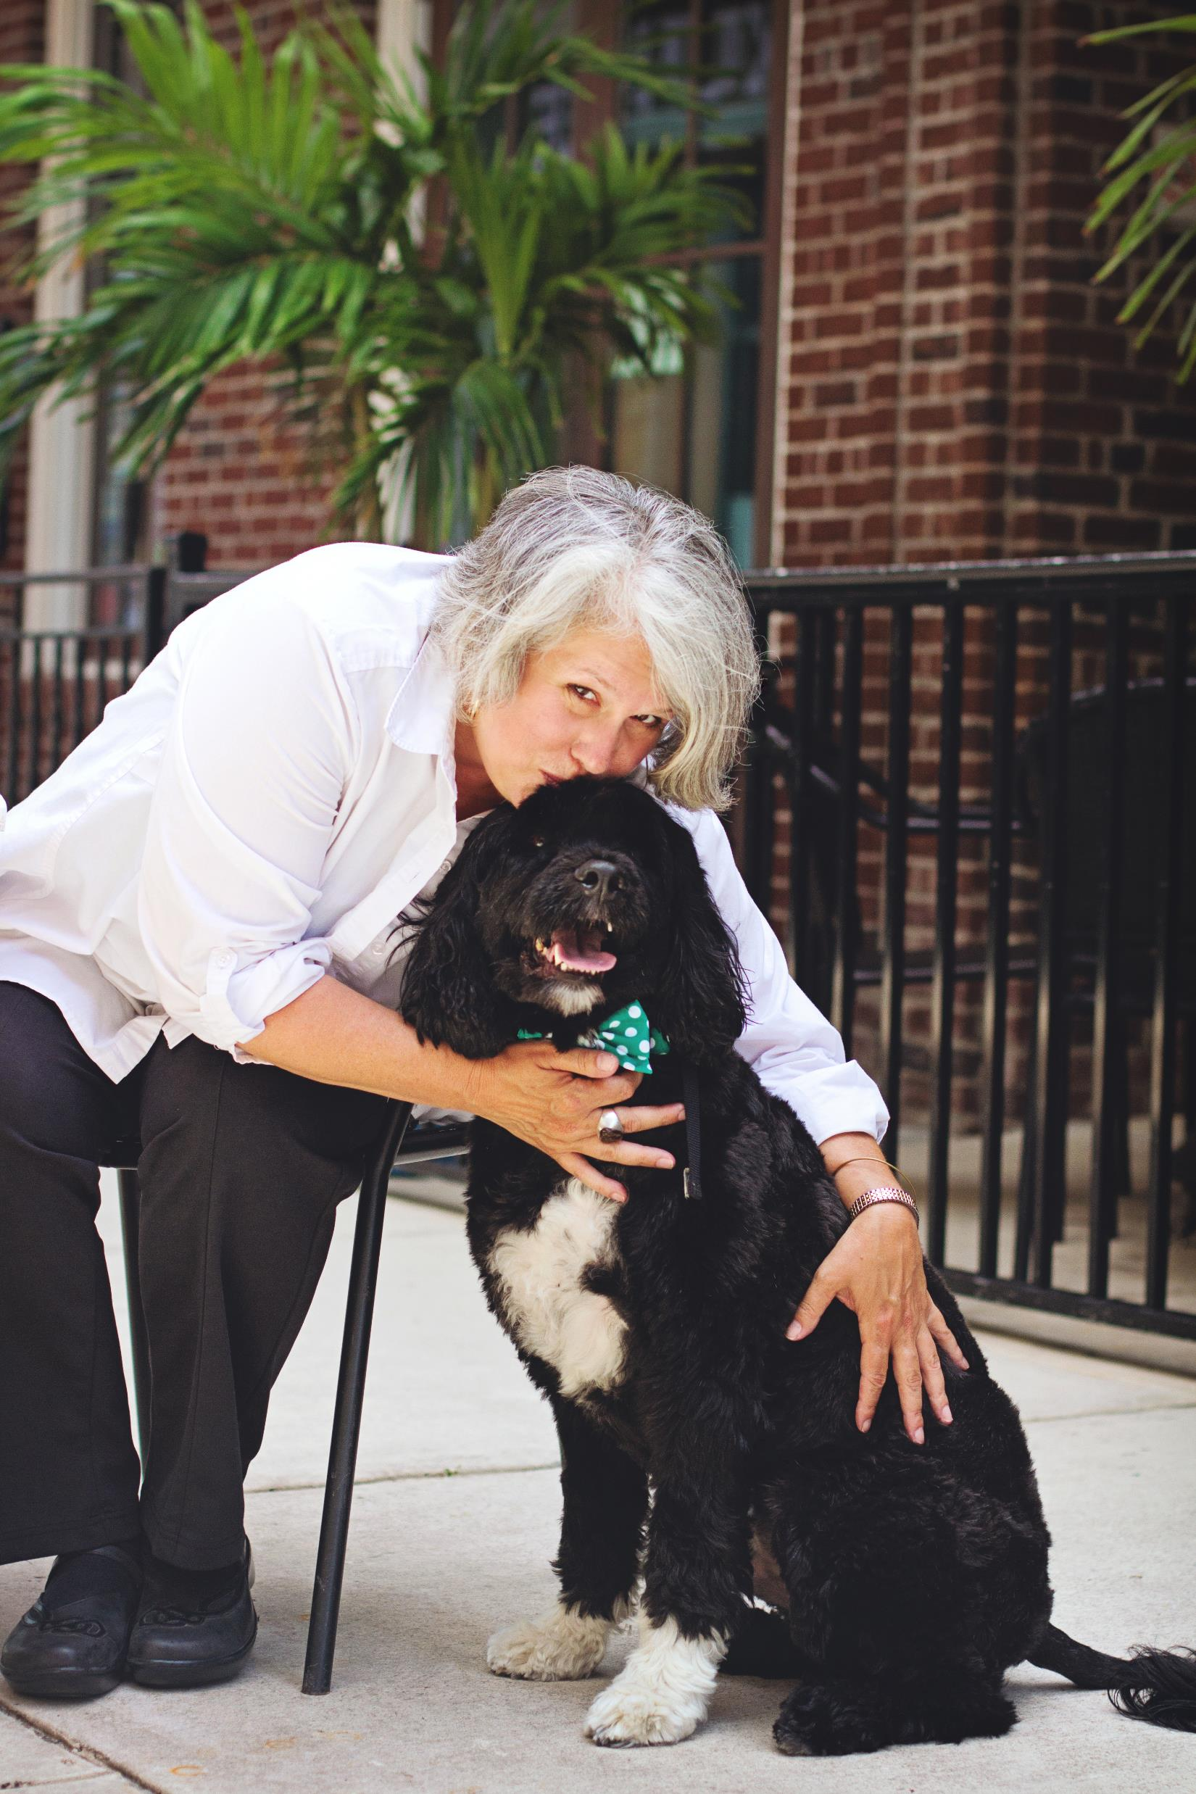
Who I am
Parent to Wils, age 27
Founder & President, Amy Van Bergen Consulting
Retired Executive Director, Down Syndrome Association of Central Florida, 1991-2016
National Down Syndrome Society Stephen Beck Jr. Advocate of the Year, 2016
Founder, Down Syndrome Affiliates in Action, 2010
The National Leadership Consortium on Developmental Disabilities, University of Delaware, 2009
Florida Developmental Disabilities Council, Education Task Force
Justice Center, Trained Special Education Mediator, 2007
Quote from my friend Jawanda: “ I am knowledgeable and still felt like I was falling off a cliff. ”
Notes:
I share this NOT toot my own horn but to let you know that you WILL make mistakes no matter how hard you try or how many workshops you attend! Adulthood is all about taking risks and trial and error.

Slide 3
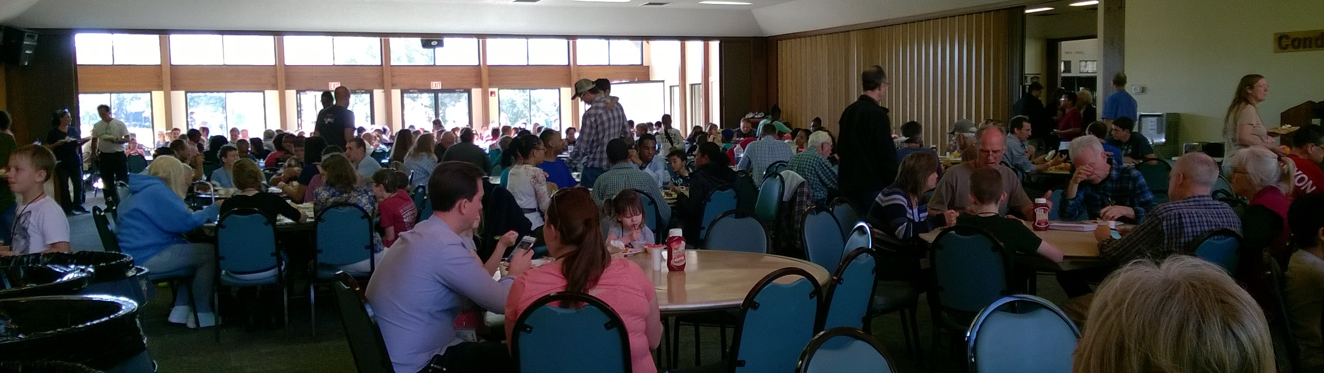
Who You Are
Notes:
Parents? Professionals? Age of children? Various disabilities? How many of you would say your loved one is the LEADER in making choices for themselves now?

Slide 4
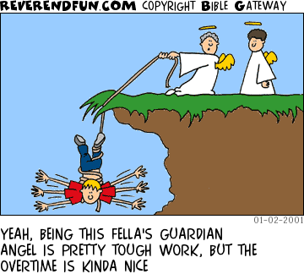

Slide 5
What We Will Cover Today
Being better prepared before you start the process of guardian advocacy/guardianship
Tips and tricks to be aware of after you are awarded Guardian Advocate status (plus advice from the experts!)
Resources just for you
Notes:
Mainly advice related to guardian advocacy but a lot of other tidbits and advice from fellow parents of adults-is there anything you hoped to hear during this portion?

Slide 6


Slide 7

Have you told your son or daughter that he/she has a disability?
Notes:
Fun with friends camp story/Bubba

Slide 8

Start early in
helping your child
find her voice
Notes:
Anna Couwenhoven was a total marshmallow in middle school. It’s not a skill so much as realizing you have some power in your own life. We worked as parents and teachers on giving her more choices and control over time. Think about this intentionally!-Terri C

Slide 9

Be Prepared Part I
Have you talked with your child’s school to see if/when they will require guardian advocate paperwork to complete for IEP meetings?
Have you talked with your child’s primary care physician to see if they will be able to serve as his/her doctor after he/she turns 18 or 21? If so, what do they require?
Are you anticipating any upcoming hospitalizations/surgeries (wisdom teeth removal, ear tubes, etc.) If so, check with them to help you determine best timeline re guardian advocate application and procedures.
If your child receives pediatric Medicaid, do you know when to reapply for them as an adult?
Are you planning a move soon in which your son/daughter would be moving to another judicial circuit?
This Photo by Unknown Author is licensed under CC BY
Notes:
Back up several more steps and 1) have you discussed your child’s diagnosis with them ever? It’s time! And 2) planning for independence starts REALLY early and must be truly planned out. Just like any other skill, our kids/adults require lots of practice. This practice comes with a bit of risk. We have to let them experience some consequences just like every other young person growing in to adulthood. Not sure that I have ideas to make things EASIER, but DEFINITELY have experienced the trials and errors along the way.

Slide 10

One tip that I have is don't wait to try independent living until your adult kid has mastered every skill. That expectation is unrealistic and may never happen. Take the plunge, they learn as they go! And, if there are skills that they can't master, get them the support that they need. It's works, they can do it!
Notes:
Carolyn Funaro-time to change how you think of your loved one. They are now an adult, the driver of their own dreams and your role is to support that, even if you may disagree. They are now the employer, the boss of all of their support people in their life.

Slide 11
Be Prepared Part II
You will need to be prepared with lots of documentation about your son or daughter
You will need to be prepared with lots of documentation about yourself (including answering any questions about late payments in your credit history OR detailed information about any treatment for a mental health condition or drug/alcohol abuse)
Any history of misdemeanor or felony convictions.
Address co-guardianship issues up front BEFORE filling
This Photo by Unknown Author is licensed under CC BY

Slide 12

This Photo by Unknown Author is licensed under CC BY-SA-NC

Slide 13
The month they turn 19 is the last month that their 'pediatric' Medicaid is in place in Florida. After that, you have to re-apply. If they receive more than $779 from SSDI, they will be denied Medicaid unless they write (in the notes at the end) that they are applying for Protected Medicaid!
Notes:
Lynn Cyr

Slide 14

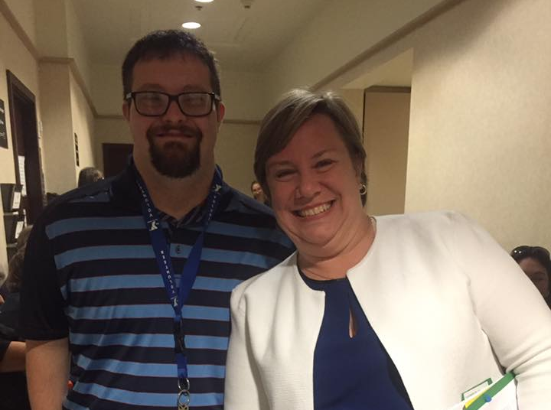
The hearing is the easy part

Slide 15


Slide 16

Tips & Tricks to be aware of after you are awarded Guardian Advocate status
If you remember nothing else it is this: “The annual plan is due the first day of the fourth month after the anniversary month.“
AND it must include a signed physician form so have this pre-printed for your child’s annual well visit (no matter when it occurs!)
Submit in person at the designated office.
PRO TIP: What else might you need a doctor’s form for? Summer camp, Adult Vocational Training sites, Access Lynx paratransit (every 3 years usually). I have learned to request 3-5 generic forms with diagnosis (Down syndrome and hypothyroidism) at every doctor visit.
This Photo by Unknown Author is licensed under CC BY-NC-ND

Slide 17
General Advice from the Parenting Trenches
Most important lifeskill ever: Make sure your teenager learns to get themselves up for school (or work) every morning
Other things to think about re independence: Are they able to turn an unfamiliar shower on and off? Take care of other self care/personal hygiene matters by themselves? If not, which ones do they specifically need help with and is there a way to get this support more naturally (like trips to a nail salon or barber shop, etc.)
From my friend Jim: just remember at all the meetings you go to about your child iep etc. you are the only one not being paid to be there

Slide 18
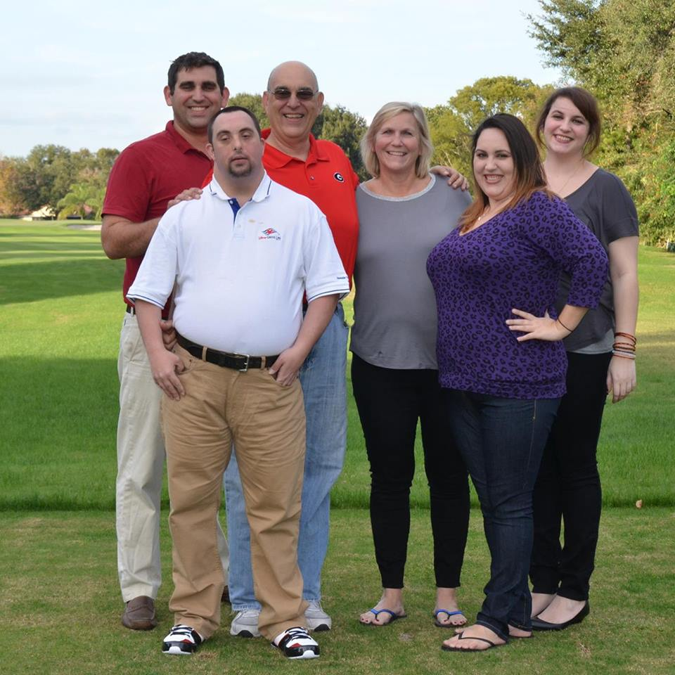
My mantra has always been “presume competence” and if you want your child/adult to be “included” you must also be willing to be “Inclusive”. You can’t hope that somebody else will create a program or start a club, if there isn’t one there, start it yourself! Make friends with other parents of children with AND without DD. There is support in numbers.
Notes:
Kathleen Mitchell

Slide 19

TRANSITION FAIRS
My advice during the transition years is to repeatedly go to any transition fair you can. There’s so many new things coming at you that you can’t possibly tackle them all at once. Go gather info, check something off the list, like SSI for example. Then go hear all the transition stuff again and tick another thing off your list, like guardianship or Power of Attorney. Then go listen and tackle another “adult” issue and keep doing that until you’ve got most of the things
taken care of. It’s overwhelming
trying to do it all at once.
Notes:
Connie Hutzel

Slide 20

This Photo by Unknown Author is licensed under CC BY-SA

Slide 21

Resources for You

Slide 22

National Supported Decision Making Resource
How would you feel if you had no say in where you live? Or where you work? Or who you spend time with? Or what you can buy and spend money on? That’s what can happen to older adults and people with disabilities when someone else has the power to make decisions for them, like when they’re put in a guardianship.
The National Supported Decision Making Resource believes that everyone has the Right to Make Choices. Supported Decision-Making is a way people can make their own decisions and stay in charge of their lives, while receiving any help they need to do so.
http://www.supporteddecisionmaking.org
Notes:
Facebook group Supported Decision Making Divas & Dudes Jawanda Mast is administrator

Slide 23

Annual Plan Forms
https://www.ninthcircuit.org/research/court-forms/probate-guardian-advocate
Form S in Orange and Osceola counties
https://flcourts18.org/attorney-citizen-resources/probate-and-guardianship-forms/
Form L in Brevard and Seminole counties
https://www.volusiabar.org/zupload/user/files/guardianadvocatehandbook.pdf
Form S with the Seventh Circuit (Volusia county)

Slide 24



https://www.woodbinehouse.com/product-category/down-syndrome/page/2/
Notes:
Similar resources re other disabilities from Woodbine House and Brooks Publishing

Slide 25

Not every person will “choose the dream” And that’s okay. Our job is to listen and support them to reach THAT dream. THEIR dream.
Be a passenger on this journey. Let them lead.
If they are living independently, teach them that they are the employer, the driver.
Respect your son/daughter’s “no.”
Our job shifts to support their choices, not make the choices FOR them.
The world is THEIRS. Even if they only have one word, they have a voice.
Notes:
Joan Medlen

Slide 26

This Photo by Unknown Author is licensed under CC BY-NC-ND

Slide 27

Questions
This Photo by Unknown Author is licensed under CC BY-SA

