Slide 1
Is a Special Needs Trust (SNT) Right for Me?
Presented by:
Heather C. Kirson, B.C.S.

Slide 2
What is a SNT?
A SNT is a trust agreement authorized by federal law that is designed to have an individual’s assets or income be excluded in means-tested public benefits calculation.
Receives and administers assets for the benefit of the individual so that the person will not be ineligible for means-tested public benefits.
Federal Law: 42 U.S. § 1396p(d)(4)(a-c)

Slide 3
Purpose
Who is it for? Individual with disabilities so they can maximize their resources to have the best quality of life.
Many individuals with disabilities rely on means-tested public benefits that have income and/or asset limits.
Examples:
  Supplemental Security Income (SSI)
  Medicaid

Slide 4
SSI & Medicaid
SSI for individual:
  $771.00 Income Limit
  $2,000.00 Asset Limit
Medicaid for individual:
  $2,313.00 Income Limit
  $2,000.00 Asset Limit

Slide 5
Types of SNTs
First Party SNT
Third Party SNT
Pooled SNT

Slide 6
What is a First Party SNT?
SNT for disabled individual
  Requires an attorney
  Medicaid Payback Provision
Name an individual person or a corporation as Trustee
Consists of assets of the beneficiary only
Commonly called “self settled” SNTs

Slide 7
Who creates a First Party SNT?
The individual or power of attorney
A parent or grandparent
Legal guardian of the individual
Or a court

Slide 8
Settlement?
What happens if there is a settlement from a personal injury or medical malpractice case?
Analysis:
  Who has legal authority over the funds?
  Does the person with disability already have control of the funds directly or through a guardian?
  If disabled individual has control of the funds requires a first party (payback) SNT

Slide 9
Inheritance?
What happens if there is an unexpected inheritance from a family member?
Same analysis. First party SNT may be required with payback provision.
Estate Planning Tip:
  Leave inheritance to disabled beneficiary on public benefits to a third party SNT instead of an outright distribution

Slide 10
First Party SNT
Concerns and Considerations
Financial ramifications
Penalties
Professional fees
Exclusions
Losing control of finances
Primary benefit rule (sole benefit rule)
On-going re-certification of eligibility for a means-tested government benefit program

Slide 11
What is a Third Party SNT?
Consists of assets of others who are not the disabled individual
Set up either during life or upon death of the person creating the trust
No Medicaid payback required
An attorney can draft a:
  Stand-alone Third Party SNT
  Testamentary SNT via Last Will & Testament or Revocable Trust

Slide 12
Who creates a Third Party SNT?
A parent or grandparent
Other family members
Other persons

Slide 13
Pooled SNT
Established and managed by a non-profit association
Separate account maintained for each beneficiary of the trust, but, for purposes of investment and management of funds, the trust “pools” these accounts
Requires signing a Joinder Agreement to “join” the trust
Funds used for sole benefit of disabled individual
Medicaid payback or if not enough retained by non-profit. If funds left over after Medicaid payback, then paid to named beneficiaries

Slide 14
Who joins a Pooled SNT?
The individual or power of attorney
A parent or grandparent
Legal guardian of the individual
Or a court

Slide 15
Other Options
Fund the Florida ABLE United account if eligible to the maximum
Spenddown plans
  Preserve/improve existing exempt resources
    Home repairs, car repairs, etc.
  Purchase new exempt resources
    Home, car, items for the home
  Prepaid funeral expense
  Prepaid living expenses
  Legally transfer wealth
  Reduce debt

Slide 16


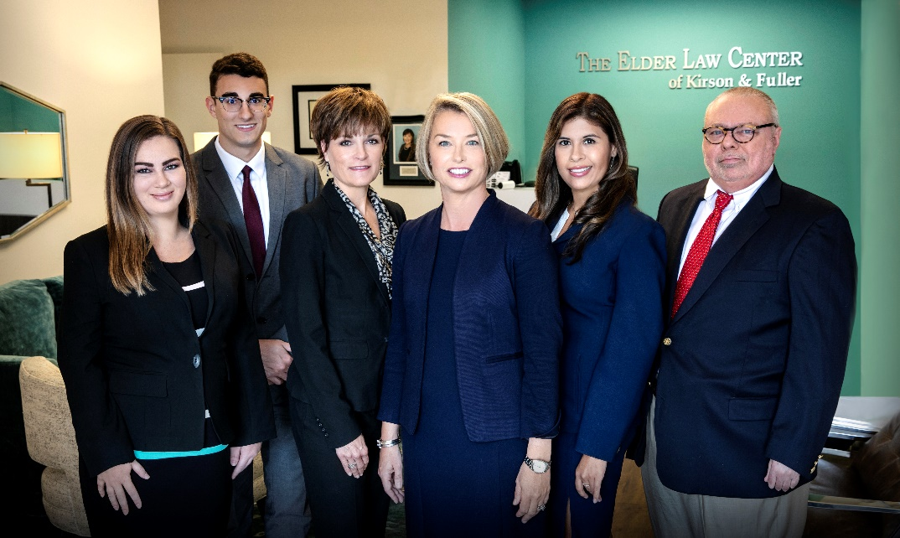
Medicaid Planning
Guardianship
Estate Planning
Special Needs Trusts
Probate & Trust Administration
1407 E. Robinson Street, Orlando, FL 32801 │Telephone: (407) 422-3017 │ www.kirsonfuller.com

