Slide 1
Overview of APD
Presented by
APD Central Region
Reed Stephan
407-768-6326
Reed.stephan@apdcares.org

Slide 2

The Agency’s Mission
The Agency Supports Persons with
Developmental Disabilities in Living, Learning,
and Working in their Communities
Notes:
The Agency for Persons with Disabilities wants people to be fully integrated into their community. We want them to work if they can. Go to the Mall to shop if they need something.

Slide 3

Whom Do We Serve?
To be eligible for services, a person must have one or more of the following diagnoses:
  Autism
  Intellectual Disability (I.Q. of 69 or below)
  Spina Bifida
  Prader-Willi Syndrome
  Cerebral Palsy
  Down Syndrome
  Phelan-McDermid Syndrome
  High Risk Child
Notes:
By law, APD serves this list of disabilities. The agency serves only individuals with Autism who are on the high end of the spectrum. We do not serve people on the low end with Asperger’s syndrome.
The High Risk category is for someone between ages 3 and 6 who is likely to be diagnosed with one of the six disabilities APD serves.

Slide 4
65G-4.015 Eligibility Criteria.
In order to be determined eligible for agency services the applicant must:
(1) Be at least three years of age.
(2) Be a resident of and domiciled in the state of Florida in accordance with Sections 222.17(1) and (2), F.S. Domicile may not be established in Florida by a minor who has no parent domiciled in Florida, or by a minor who has no legal guardian domiciled in Florida, or by any alien not classified as a resident alien. Dependents of active duty military personnel stationed in the state of Florida are exempt from residency and domicile requirements.
(3) Have a confirmed diagnosis of one of the following developmental disabilities as defined in this these rules, Rules 65G-
4.014, 4.015, 4.016 and 4.017, F.A.C.:
(a) Autism;
(b) Cerebral palsy;
(c) Mental retardation or intellectual disability;
(d) Prader-Willi syndrome;
(e) Spina Bifida;
(f) Down Syndrome, or
(g) Children between 3 and 5 years of age who are at high risk of later diagnosis of one of the disabilities listed above. Such high-risk children shall not be placed on the waiting list for waiver services until a confirmed diagnosis of a qualifying disability is given.
(4) DD Waiver services are only available (conditioned upon the wait list) to persons who meet the requirements of 42 CFR
§435.217(b)(1) for receiving home and community-based services. It is mandatory that the determination is made that without DD Waiver services these individuals would otherwise require the level of care furnished in a hospital, nursing home, or an Intermediate Care Facility for People with Intellectual Disabilities (referred to in the CFR as an “ICF/MR”).
Rulemaking Authority 393.065, 393.501 FS. Law Implemented 393.065 FS. History–New 5-16-12.

Slide 5
Definition of High Risk Child
A Child 3 – 5 years of age with one or more of the following characteristics:
  A developmental delay in cognition, language or physical development
  A child surviving a catastrophic infectious or traumatic illness known to be associated with developmental delay
  A child with a parent or guardian with developmental disabilities who requires assistance in meeting the child’s development needs
  A child who has a physical or genetic anomaly associated with developmental disability

Slide 6
65G-4.014 Eligibility for Agency Services – Definitions
(1) Autism means a condition which meets the requirements of Section 393.063, F.S., that the condition is:
(a) Pervasive, meaning always present and without interruption;
(b) Neurologically based, meaning that the condition is not the result of physical impairment;
(c) A developmental disability with age of onset during infancy or childhood;
(d) With extended duration, meaning that the condition reasonably can be expected to continue indefinitely into the future;
(e) Causes severe learning disorders resulting in both severe communication disorders affecting both verbal and nonverbal skills, and severe behavior disorders. Autism is characterized by an individual evidencing at least six of the following twelve features from the following subparts 1 and 2, with at least one feature from subpart 2:
1. Severe communication disorders, which may include:
a. A delay in, or total lack of, the development of spoken language (not accompanied by an attempt to compensate
through alternative modes of communication such as gesture or mime);

Slide 7
65G-4.014 Eligibility for Agency Services – Autsim
b. Stereotyped and repetitive use of language or idiosyncratic language;
c. For those applicants with speech, marked impairment in the use of multiple nonverbal behaviors such as eye to-eye gaze, facial expression, body postures, and gestures to regulate social interaction;
d. Failure to develop peer relationships appropriate to developmental level;
e. A lack of spontaneous seeking to share enjoyment, interests, or achievements with other people (e.g., by a lack of showing, bringing, pointing out objects of interest, or achievements to others);
f. Lack of social or emotional reciprocity;
g. Marked impairment in the ability to initiate or sustain a conversation with others in individuals with adequate speech; or
h. Impaired imaginative ability evidenced by a lack of varied, spontaneous make-believe play or social imitative play appropriate to developmental level.
2. Severe behavior disorders, which are restricted, repetitive and stereotyped patterns of behavior, interests, and activities which may include:

Slide 8
65G-4.014 Eligibility for Agency Services – Autism
a. Encompassing preoccupation with one or more stereotyped and restricted patterns of interest that is abnormal either in intensity or focus;
b. Apparently inflexible adherence to specific, nonfunctional routines or rituals
c. Stereotyped and repetitive motor mannerisms (e.g., hand or finger flapping or twisting, or complex whole-body movements); or
d. Persistent preoccupation with parts of objects.

Slide 9
65G-4.014 Eligibility for Agency Services – Cerebral Palsy
(2) Cerebral Palsy – means a group of disabling symptoms of extended duration that result from damage to the developing brain during the prenatal period and characterized by paralysis, spasticity, or abnormal control of movement or posture, such as poor coordination or lack of balance, which is manifest prior to three years of age. For purposes of the rule, cerebral palsy also means the presence of other significant motor dysfunction appearing prior to age 18 due to perinatal or external events such as anoxia, oxygen deprivation, or traumatic brain injury. Excluded from this definition is motor dysfunction caused by medical events, including stroke or progressive diseases such as muscular dystrophy. The impairment from cerebral palsy must constitute a substantial handicap which is reasonably expected to continue indefinitely.

Slide 10
65G-4.014 Eligibility for Agency Services – Intellectual Disability
(3) Mental Retardation or Intellectual Disability – is evidenced by the concurrent existence of:
(a) Significantly subaverage general intellectual functioning evidenced by an Intelligence Quotient (IQ) two or more standard deviations below the mean on an individually administered standardized intelligence test; and,
(b) Significant deficits in adaptive functioning in one or more of the following areas:
1. Communication skills,
2. Self-care, home living,
3. Social and interpersonal skills,
4. Use of community resources and self-direction,
5. Functional academic skills,
6. Work, leisure, health and safety awareness and skills,
(c) Which are manifested prior to age 18; and,
(d) Constitute a substantial handicap which is reasonably expected to continue indefinitely.

Slide 11
65G-4.014 Eligibility for Agency Services – Prader-Willi Syndrome, Spina Bifida and Down Syndrome
(4) Prader-Willi Syndrome – means a genetic disorder which is most often associated with a random deletion of chromosome 15. Commonly associated characteristics include insatiable appetite, chronic overeating, hypotonia, short stature, obesity, and behavioral issues. Individuals diagnosed with Prader-Willi syndrome generally have mental retardation; however, an individual with Prader-Willi syndrome can be determined as eligible for services without an accompanying diagnosis of mental retardation.
(5) Spina Bifida – For the purposes of agency eligibility, spina bifida refers to a confirmed diagnosis of spina bifida cystica or myelomeningocele.
(6) Down Syndrome – means a condition caused by the presence of extra chromosomal material on chromosome 21. This disorder is often associated with impairment in cognitive ability, characteristic physical growth and features, and congenital medical conditions.

Slide 12
65G-4.014 Eligibility for Agency Services – Definitions
(7) Eligibility Rules – Rules 65G-4.014 through 65G-4.017, F.A.C., inclusive, which apply to eligibility determinations for services provided through the Agency for Persons with Disabilities for individuals with developmental disabilities.
(8) DD Waiver – Home and Community-Based Services (HCBS) waiver authorized by 42 U.S.C. 1396n(c)(1) of the federal Social Security Act and Section 409.906, F.S., that provides a package of Medicaid-funded home and community-based supports and services to eligible persons with developmental disabilities who live at home or in a home-like setting.
(9) Agency Services – home and community based supports and services to eligible persons funded through general revenue allocations or sources other than the DD Waiver.
Rulemaking Authority 393.065, 393.501 FS. Law Implemented 393.065 FS. History–New 5-16-12.

Slide 13
Application Process
Via APD Office
Call 407-245-0440
  Request application
Referral form completed
Referral is logged
Application is sent out
Via School Referral
Teacher/LEA email/fax or mail
Referral is logged
Application is sent out

Slide 14
65G-4.016 Application Process
(1) Application for services from the agency shall be made by submitting an application by hand delivery, U.S. Postal Service, or facsimile to the agency office in the service area where the applicant resides. The Application for Services (Form 10-007, 2007), is available on the agency website at www.apd.myflorida.com, http://www.apd.myflorida.com/customers/application/ or by contacting the agency. The application is available in English and Spanish and is hereby incorporated by reference, http://www.flrules.org/Gateway/reference.asp?No=Ref-01203.
(2) Upon receipt of a completed, signed, and dated Application for Services, the area agency staff shall review the application and supporting documentation and, within 45 days for children under the age of 6 and 60 days for individuals 6 years of age and older, shall notify the applicant of the final determination of eligibility for agency services. If requests for collateral information or additional evaluations are necessary to determine eligibility, the time may be extended for no more than an additional ninety (90) days.

Slide 15
65G-4.016 Application Process
(3) If an applicant is unable to produce an existing evaluation that establishes eligibility or if there is concern that the information provided is inaccurate, incorrect, or incomplete, the agency area office will be responsible for obtaining an evaluation to establish eligibility. Professional diagnoses under Rule 65G-4.017, F.A.C., must document all criteria for eligibility as set forth in Rules 65G-4.014-.017, F.A.C. The evaluation process includes only those assessments necessary to determine eligibility that were administered by a person qualified to administer the instrument(s).
(4) When the eligibility determination is complete, the agency area office shall notify the applicant in writing within five (5) business days of the decision. If the applicant is determined ineligible for agency services, the agency area office shall notify the applicant of the right to appeal the decision in accordance with Chapter 120, F.S.
(5) If the applicant is determined to be ineligible to receive services from the agency, the agency area office shall offer suggestions regarding other programs, agencies, or services for which the applicant may be eligible.

Slide 16
65G-4.016 Application Process
(6) If a category of covered conditions in this rule is not also covered by the state’s Medicaid developmental disabilities waiver (DD waiver) at the time an individual is determined to be eligible, those individuals will be placed on the waiting list and may be provided services funded through general revenue allocations or sources other than the DD Waiver.
Rulemaking Authority 393.065, 393.501 FS. Law Implemented 393.065 FS. History–New 5-16-12.

Slide 17
Once Application Is Received
Application is reviewed for all necessary documentation
  Contact will be made if additional detail is required
If approved – client receives letter advising of such and letting them know they are on the Wait List and at what category
ALL APPROVIED CLIENTS ARE PUT ON THE WAIT LIST
If not approved – client receives letter detailing why not approved and what steps they are available to appeal the decision

Slide 18
65G-4.017 Establishing Eligibility
(1) Establishing Eligibility – Autism. A diagnosis of autism, as defined by Rule 65G-4.014, F.A.C., may only be made by one or more of the following who has specific training and experience in making such diagnosis:
(a) A Florida-licensed psychiatrist;
(b) A Florida-licensed psychologist;
(c) A board-certified pediatric neurologist who is qualified by training and experience to make a diagnosis of autism;
(d) A board-certified developmental pediatrician, or
(e) Collateral information received from another state may be accepted if the evaluator is licensed through the same credentials required for licensure in Florida for the professions listed in paragraph (1)(a), above.
(2) Establishing Eligibility – Cerebral Palsy. Diagnosis is confirmed by written documentation from one or more of the following:
(a) A medical doctor;

Slide 19
65G-4.017 Establishing Eligibility, contd.
(b) A doctor of osteopathy, or
(c) Medical records documenting a diagnosis of cerebral palsy before the age of 18.
(3) Establishing Eligibility – Mental Retardation or Intellectual Disability. To establish that an individual has mental retardation the following criteria shall be applied:
(a) A single test or subtest should not be used alone to determine eligibility. If a person has significantly different (statistically defined) scores on different scales of a test or tests, or a great deal of variability on subtest scores of an IQ test, the full-scale score may not indicate mental retardation and should not be relied on as a valid score. In that instance, closer scrutiny is required to make an appropriate differential diagnosis. This may include review of school records, school placement, achievement scores, medical records, medication history, behavior during testing and the psychosocial situation at the time of testing. Closer scrutiny must also be required when there is a great deal of variability between IQ scores on different IQ tests or different administrations of the same IQ test. Nothing here is intended to preclude clinical judgment from appropriately determining that a single full-scale IQ score of 70 or below, or two or more standard deviations below the mean, on an individually administered intelligence test is sufficient to establish eligibility.

Slide 20
65G-4.017 Establishing Eligibility, contd.
(b) The performance measures for this category of adaptive functioning deficits must be validated by the professional judgment of a psychologist who is experienced in working with people who have retardation, who has specific training and validation in the assessment instrument that is used, and who is one of the following:
1. A Florida-licensed psychologist,
2. A Florida-licensed school psychologist,
3. A certified school psychologist.
(c) Any standardized test may be submitted as proof. However, the applicant must demonstrate that any test not presumptively accepted by the agency is valid. The following are presumptively accepted standardized tests of intelligence to establish eligibility for mental retardation:
1. Stanford-Binet Intelligence Test (all ages),
2. Wechsler Preschool and Primary Scale of Intelligence (under six years of age),
3. Differential Ability Scales – Preschool Edition (under six years of age),

Slide 21
65G-4.017 Establishing Eligibility, contd.
4. Wechsler Intelligence Scale for Children (WISC) (children up to 15 years, 11 months),
5. Differential Ability Scales (children up to 15 years, 11 months),
6. Wechsler Adult Intelligence Scale (WAIS),
7. Test of Nonverbal Intelligence-3 (TONI-3),
8. Comprehensive Test of Nonverbal Intelligence-2 (C-TONI 2),
9. Universal Nonverbal Intelligence Test (UNIT),
10. Leiter International Performance Scale-Revised (Leiter-R).
(d) The following tests of adaptive functioning are presumptively accepted in the determination:
1. Vineland Adaptive Behavior Scales,
2. AAMR Adaptive Behavior Scale,
3. Adaptive Behavior Assessment System (ABAS),
4. Adaptive Behavior Evaluation Scale (ABES).

Slide 22
65G-4.017 Establishing Eligibility, contd.
5. Scales of Independent Behavior-Revised
(e) In all cases, assessments or evaluations for eligibility should be obtained from appropriately licensed professionals with experience and training in the instruments and population for whom eligibility is to be determined.
(4) Establishing Eligibility – Prader-Willi Syndrome. Diagnosis is confirmed by written documentation from one or more of the following:
(a) A medical doctor;
(b) A doctor of osteopathy, or
(c) Medical records that document a diagnosis of Prader-Willi syndrome before the age of 18.
(5) Establishing Eligibility – Spina Bifida. Diagnosis is confirmed by written documentation from one or more of the following:
(a) A medical doctor;
(b) A doctor of osteopathy, or
(c) Medical records that document a diagnosis of spina bifida cystica or myelomeningocele before the age of 18.

Slide 23
65G-4.017 Establishing Eligibility, contd.
(6) Establishing Eligibility – Down Syndrome. Evidence under this category requires medical records documenting a chromosome analysis (also referred to as a karyotype) finding the individual has an extra genetic material on their number 21 chromosome.
(7) Establishing Eligibility – High-Risk Children, 3 to 5 years of age. Evidence under this category requires a determination by an APD area office that a medical diagnosis of developmental delay evidenced by the child indicates a high probability that the child is likely to have an eventual diagnosis of a qualifying condition under Rule 65G-4.014, F.A.C., if early intervention services are not provided, or the child has one or more physical or genetic anomalies associated with a developmental disability, such as:
(a) Genetic or chromosomal disorders (such as Down syndrome or Rett syndrome);
(b) Metabolic disorders (such as phenylketonuria);
(c) Congenital malformations (such as microcephaly or hydrocephaly);
(d) Neurological abnormalities and insults;
(e) Congenital and acquired infectious diseases;

Slide 24
65G-4.017 Establishing Eligibility, contd.
(f) Chronic or catastrophic illnesses or injuries;
(g) A parent or guardian with developmental disabilities who requires assistance in meeting the child’s developmental needs, or
(h) Other conditions or genetic disorders generally associated with developmental disabilities, such as tuberous sclerosis, congenital syphilis, fetal alcohol syndrome, or maternal rubella, as documented by a physician.
(i) If a child between three and five years of age already has been determined to have a developmental disability in one of the five categories identified in Chapter 393, F.S., that child shall be eligible for services from the agency under the appropriate diagnosis and shall be added to the waiting list.
(j) If a child served under the category of high risk does not have a confirmed diagnosis by his or her fifth birthday, they shall be given a notice of case closure and the case will be closed at the agency. The agency shall make the child’s parent or guardian aware of appropriate agencies, programs or school programs which the agency is aware of which might be able to assist the child.
Rulemaking Authority 393.065, 393.501 FS. Law Implemented 393.065 FS. History–New 5-16-12.

Slide 25
65G-1.047 Crisis Status Criteria.
“First priority” crisis category: The applicant is currently homeless, living in a homeless shelter, or living with relatives in an unsafe environment. In such cases, the following indicia, supported by credible evidence, are relevant to a crisis determination in this category:
(a) Without immediate provision of waiver services, the health and safety of the applicant are at risk;
(b) The applicant has no shelter available and needs emergency placement by the Agency or another state agency;
(c) Alternative funding is not available for other placement and services to the applicant;
(d) The applicant temporarily is staying with friends or relatives but residence is not expected to last more than several weeks;
(e) The applicant’s caregiver has no legal obligation to provide shelter to the applicant and the caregiver’s commitment to shelter the applicant is low;
(f) Factors affecting the applicant’s safety in the current setting include risk of physical abuse of the applicant or risk of insufficient supervision and support;
(g) The home has insufficient room to shelter the applicant, or the applicant must share a room in an inappropriate living arrangement, based on the ages, genders, and conditions of the persons sharing the room;
(h) The applicant’s desire for placement creates a reasonable expectation that the applicant will be cooperative with placement;
(i) Violence or illegal activities within the applicant’s current living environment by the applicant or others has required the intervention of local or state law enforcement authorities;
(j) Complaints of neglect, exploitation, or abuse of the applicant to Protective Services, or other adverse environmental conditions affecting the applicant, have been investigated and confirmed pursuant to Chapter 39, Part II, or Section 415.104, F.S.;
(k) The applicant requires services of greater intensity.

Slide 26
“Second priority” crisis category: The applicant exhibits behaviors that, without provision of immediate waiver services, may create a life-threatening situation for the applicant or others, or that may result in bodily harm to the applicant or others requiring emergency medical care from a physician. In such cases, the following indicia supported by credible evidence are relevant to a determination of crisis under this category:
(a) Without immediate waiver services, the health and safety of the applicant or others in the household is at risk;
(b) The applicant’s injury to self or others is frequent or intense;
(c) The applicant or others are at risk for serious injury or permanent damage;
(d) There is documentation of medical treatment for the applicant’s injury to self or others;
(e) No other supports are available to address the applicant’s behaviors;
(f) Other attempted behavioral assessments and interventions have proven ineffective;
(g) The relative ages, sexes, and sizes of the aggressor and the subjects of aggression place the subjects of aggression at risk of injury;
(h) The caregiver has insufficient ability to control the applicant;
(i) The ages or disabilities of the applicant or caregiver exacerbate the problems;
(j) Violence or illegal activity within the applicant’s current living environment by the applicant or others has required the intervention of local or state law enforcement authorities;
(k) Complaints of neglect, exploitation, or abuse of the applicant, or other adverse environmental conditions affecting the applicant have been investigated by Protective Services and confirmed pursuant to Chapter 39, Part II, or Section 415.104, F.S.;
(l) The applicant requires services of greater intensity.

Slide 27
“Third priority” crisis category: The applicant’s current caregiver is in extreme duress and is no longer able to provide for the applicant’s health and safety because of illness, injury, or advanced age. The applicant needs immediate waiver services to remain living with the caregiver or to relocate to an alternative living arrangement. In such cases, the following indicia, supported by credible evidence, are relevant to a determination of crisis in this category:
(a) Without immediate provision of waiver services, the applicant’s health and safety are at imminent risk;
(b) Other potential caregivers, such as another parent, stepparent, brother, sister or other relative or person, are unavailable or are unwilling or unable to provide care;
(c) The caregiver’s physical or mental condition prevents the provision of adequate care;
(d) The caregiver is deceased, about to expire, or permanently disabled;
(e) The caregiver’s age impairs the caregiver’s ability to provide sufficient care to the applicant;
(f) The caregiver cannot provide sufficient care because of the age or size of the applicant, or the physical, functional, or behavioral demands of the applicant;
(g) The services provided by the caregiver are limited in amount, duration, or frequency, rendering the applicant semi-dependent or totally dependent;
(h) The caregiver’s economic situation is unstable and unlikely to improve as a result of the care-giving demands of the applicant;
(i) The caregiver’s obligations to the needs of other dependents prevent the caregiver from providing the applicant with adequate care, or the caregiver’s obligation of care to the applicant places other dependents at risk of insufficient care;
(j) Violence or illegal activities within the applicant’s current living environment by the applicant or others has required intervention by local or state law enforcement authorities;
(k) Complaints of neglect, exploitation, or abuse of the applicant, or other adverse environmental conditions affecting the applicant have been investigated by Protective Services and confirmed pursuant to Chapter 39, Part II, or Section 415.104, F.S.;
(l) The individual requires services of greater intensity.

Slide 28
Wait List Client Services
Supported Employment – EEP – Employment Enhancement Program
  Discovery
  Follow Along – short term or indefinitely
Durable medical supplies
Respite Care – provides supportive care and supervision for individuals under 21 when the caregiver is unable to
Personal Supports - assistance and training in daily activities
Supported Living Coaching – Short term – support individuals who maintain their own residences

Slide 29
Most APD Customers Are
Served Through the Waiver
APD currently serves almost 53,000 Floridians with developmental disabilities
  33,000+ people in the Medicaid Waivers
  20,000+ people are on the Waitlist
  9,500+ receive other services
  700+ people in Developmental Disabilities Centers
  207+ in forensic programs (DDDP and others)
Notes:
This slide shows the number of people receiving traditional services from the agency. APD also provide waiver support coordination to all 21,003 people on the waiting list. Also most of the 7,591 people listed as receiving other services, are people on our waiting list.
As of Aug 1, 2013, 17,357 waiting list customers are receiving Medicaid State Plan services.

Slide 31


iBudget Florida
Approximately 33,000 Floridians are currently enrolled in iBudget Florida
iBudget Florida is a better way for APD to manage the Home and Community-Based Medicaid waiver
Customers choose, with assistance from their waiver support coordinator, how they want to spend their yearly budget
iBudget Florida is a simpler and more equitable, self-directed, and sustainable system
iBudget Florida gives customers wider choices, greater flexibility, and more control over their services.
31
Notes:
31

Slide 32
What is an iBudget????
An annual budget amount – based on client need
Client chooses a Waiver Support Coordinator to assist with budget and service Providers
Client/family determines what services they wish to utilize with their iBudget
Client/family chooses the Provider for those services
Waiver Support Coordinator & APD process the authorization for each service (contract between Client and Provider)
Services are given by Providers

Slide 33
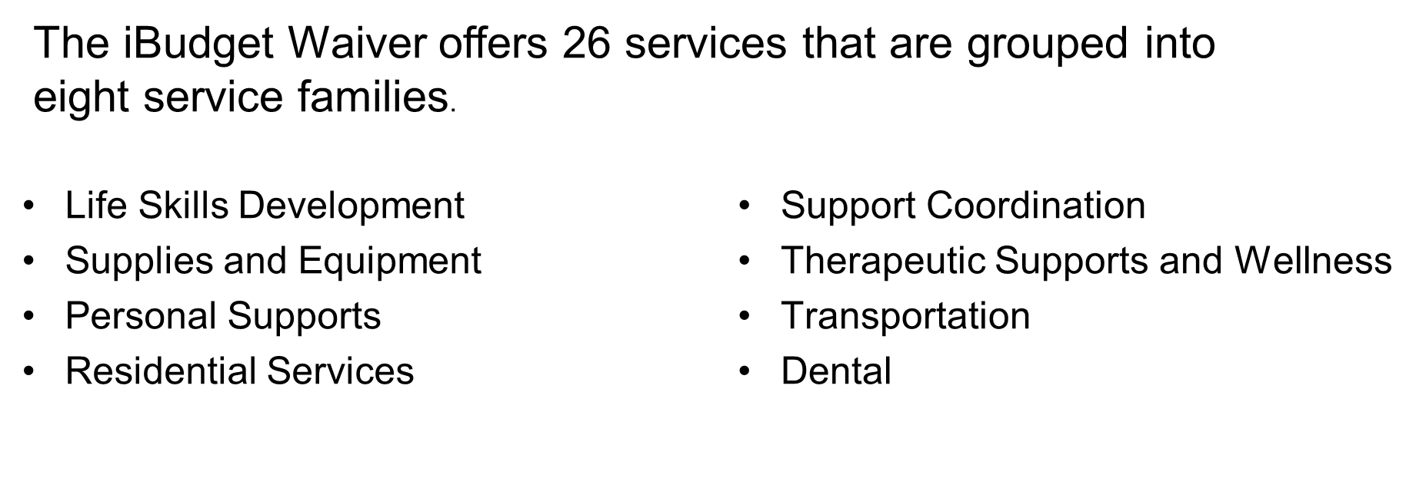
iBudget Waiver Service Families

Slide 34
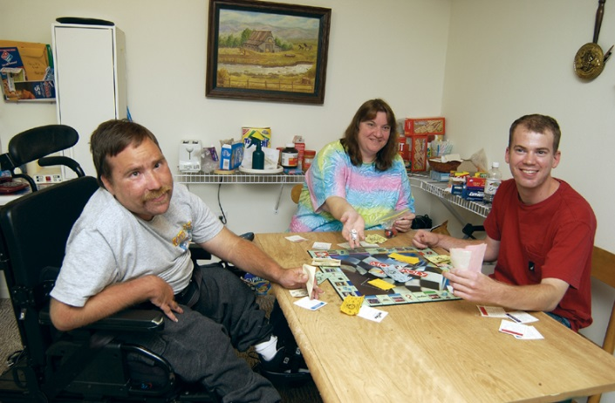
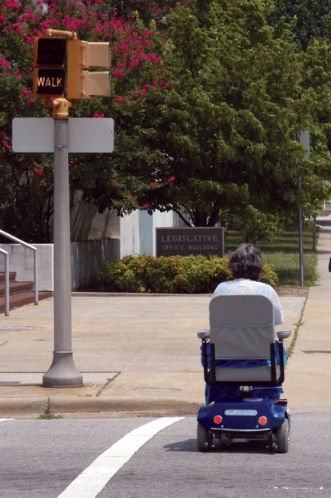

Life Skills Development
Level 1 – Companion Services
  Nonmedical Care
  Supervision
  Socialization Activities
Level 2 – Supported Employment
  Job Search Assistance
  Develop or Operate Small Business
Level 3 – Adult Day Training
  Community Participation
  Volunteer
  Access Community Resources
  Self-Advocacy
34
Notes:
34

Slide 35
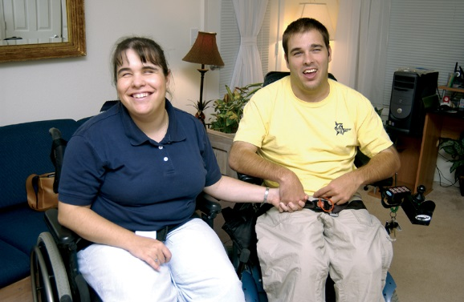
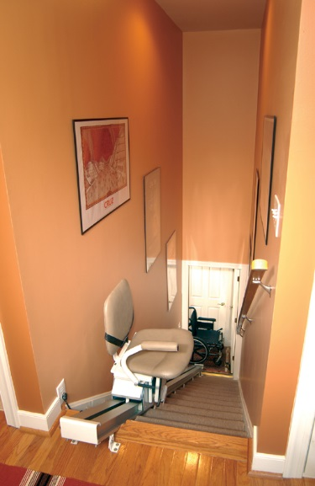
Supplies and Equipment
Consumable Medical Supplies:
  Nonmedical Supplies and Items to assist people with daily living activities
  For people 21 and older
  Unavailable through State Medicaid Plan
Durable Medical Equipment / Supplies:
  Must Have a Prescription
  Examples are lap trays, grab bars, adaptive switches,
  door openers
  Unavailable through State Medicaid Plan
Environmental Accessibility Adaptations:
  Physical Adaptations to the Home
  Medically Necessary
  Enable Greater Independence in their Home
Personal Emergency Response System:
  Enable Greater Independence in their Home
35
Notes:
35

Slide 36
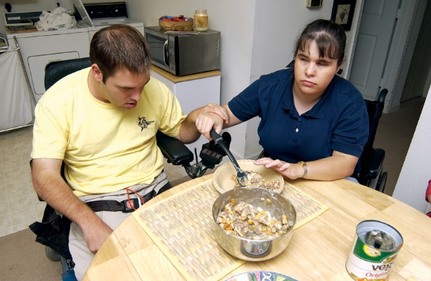
Personal Supports
Personal Supports
  Assistance and training in activities of daily living such as eating, bathing, dressing, personal hygiene, and preparation of meals
Respite Care
  Provides supportive care and supervision for individuals under 21 when the primary caregiver is unable

Slide 37
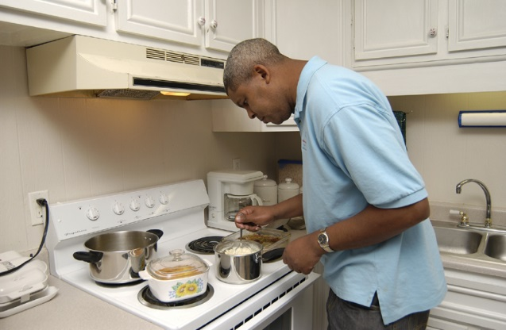

Residential Services
Residential Habilitation:
  Daily living skills training and supervision
  Personal Hygiene Skills
  Homemaking Skills
  Social and Adaptive Skills
Standard Residential Habilitation:
  Assist people to acquire, maintain, or improve
  daily living skills
Behavior-Focused Residential Habilitation:
  More Intense Level of Service
  Impacts safety, health, progress, and quality of life
Intense Behavior Residential Habilitation:
  Behavior that is exceptional in intensity, duration, and frequency
  Needs cannot be met in a Standard or Behavior-Focused setting
37
Notes:
37

Slide 38


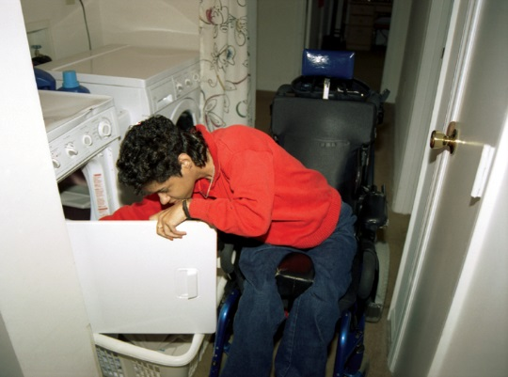
Residential Services
Special Medical Home Care:
  24-Hour Nursing and Medical Supervision
  Licensed Group Home
  For People with Complex Medical Needs
Supported Living Coaching:
  Wide Variety of Training and Assistance
  Support People Who Live and Maintain
  Own Homes or Apartments
38
Notes:
38

Slide 39
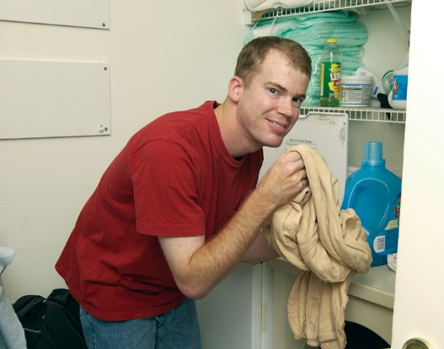


Support Coordination
Limited Support Coordination
  Basic supports that are less intense
Full Support Coordination:
  Significant Support to Ensure Peoples Health, Safety
  and Well-Being
  WSC Can Share Tasks with Individual, Family
  or Other Support People
  Age 21 and Older
  Children in Foster Care
Enhanced Support Coordination:
  Transition from Nursing Facility or ICF/DD to Community
  Assists People Who Need a More Intensive Level of Support
39
Notes:
39

Slide 40
Therapeutic Supports & Wellness
Behavior Analysis Services:
  Goal to Change Behavior
  Analysis
  Development
  Modification
  Monitoring
Behavior Assistant Services:
  Provided for Limited Time
  Supervised by a Behavior Analyst
  Goal to Train Paid / Unpaid Support People to Assist
  Individual to Function More Independently
Specialized Mental Health Counseling:
  For People with Developmental Disabilities and Mental Health Diagnosis
  Restore to Highest Functional Level
40
Notes:
40

Slide 41

Therapeutic Supports and Wellness
The following services require a prescription and are for people 21 and older:
  Private Duty Nursing
  Residential Nursing
  Skilled Nursing
  Dietician Services
  Respiratory Therapy
  Speech Therapy
  Occupational Therapy
  Physical Therapy
41
Notes:
41

Slide 42
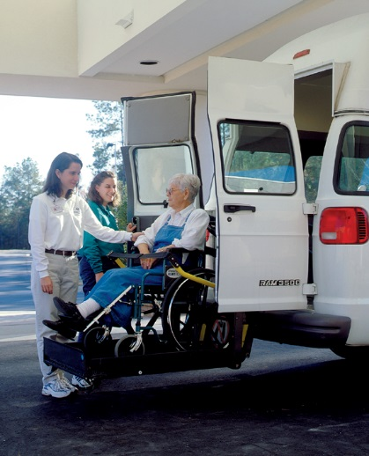

Transportation
Dental
  Rides to and from waiver services, including employment and day programs
  Dental care for individuals over the age of 21

Slide 43
Supported Employment – Life Skills Development II
Phase One
Assessments to determine goals, preferences and skills
Assist with resume development, mock interviews and completion of job applications
Job Development for a specific individual by connecting with employers
Intensive, on-the-job training and consultation focused on building skills needed to meet employer productivity, appropriate behavior and social acceptance
Phase Two
Follow Along - Ongoing contact with employed client to determine need and frequency of support
Educative OJT to meet employer expectations and refinement of support
Related supports – transportation
Work with the employer to expand work benefits, hours and responsibilities
Social Security wage reporting & work incentive

Slide 44
Elizabeth Watson Alvaro Quintero
APD Employment Liaison APD Employment Liaison
901 Industrial Dr. Ste. 100 400 W. Robinson Street
Wildwood, FL 34785 Orlando, FL 32801
Ph: (352) 330-2739 Ph: (407) 768-6327
elizabeth.watson@apdcares.org alvaro.quintero@apdcares.org
Mollie Brown-Ferrier
APD Employment Liaison
200 N. Kentucky Ave. Ste. 422
Lakeland, Fl. 33801
Ph: (863) 413-3377
mollie.brown-ferrier@apdcares.org

Slide 45
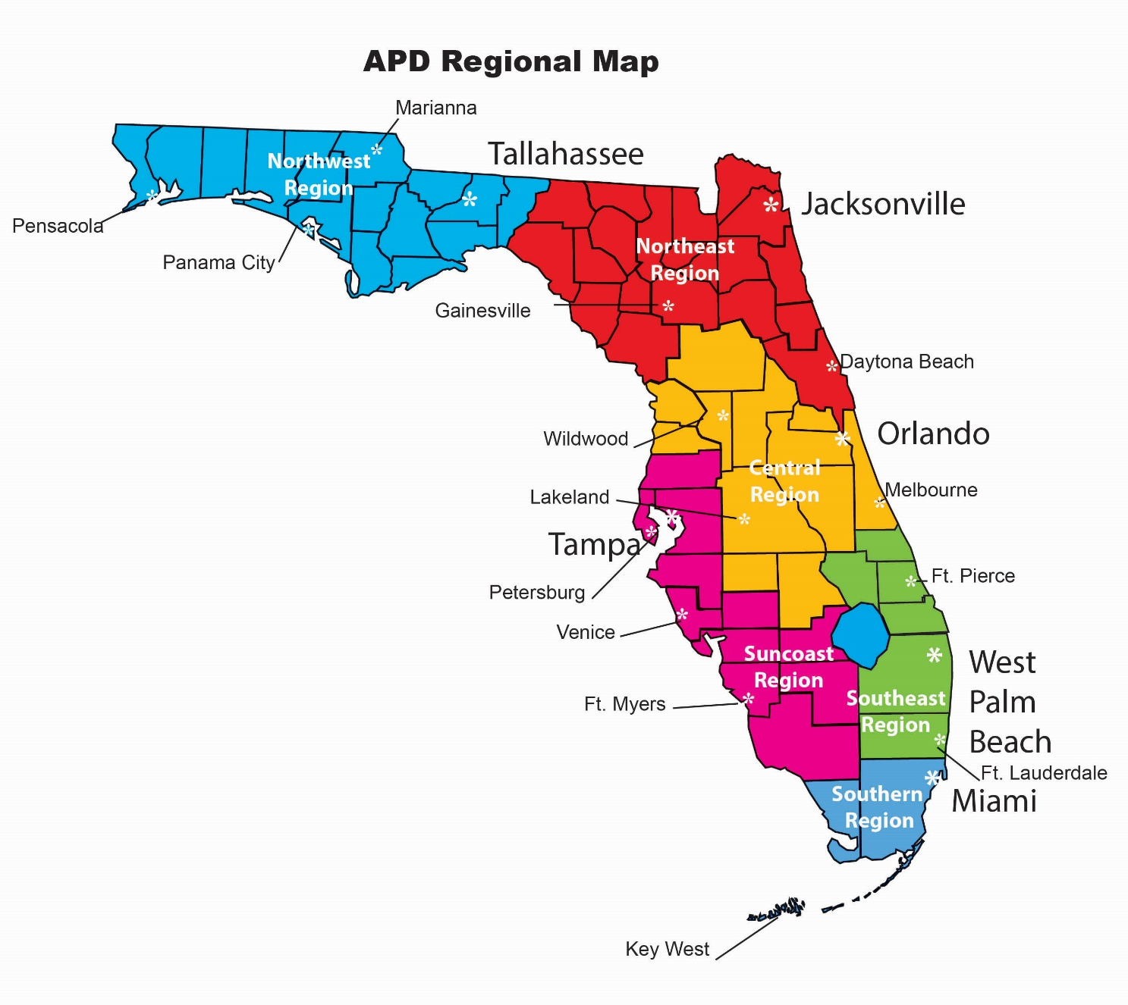
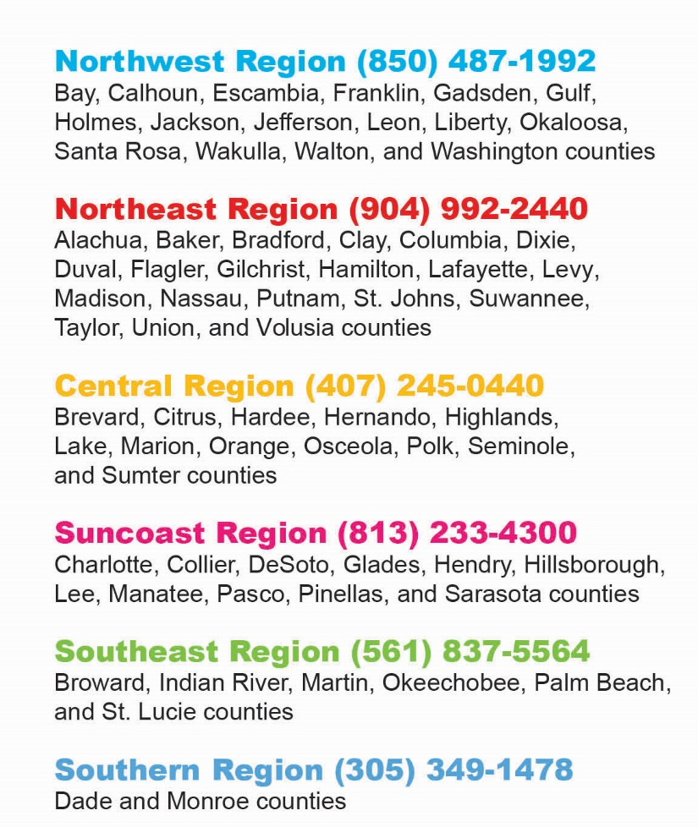
45
Notes:
45

Slide 46
Thank You!
For more information about APD….
  Call 1-866-APD-CARES (1-866-273-2273)
  Visit APDCares.org
  Visit iBudgetFlorida.org

