Slide 1


Transition Planning
Notes:
Transition services and planning is really just a road map to life after high school….
How will the student get to the chosen destination?
The more technical definition for Transition Services is
“a coordinated set of activities for a child with a disability that—is designed to be within a results-oriented process,
But focused on improving their academic and functional achievement ---to get them moving from school to post-school activities. ---including:
post-secondary education
vocational education
integrated employment (including supported employment)
continuing and adult education
adult services,
independent living
or community participation;
guardian advocate

Slide 2



Family Driven
Non-Profit 501(c)3
Notes:
We are a 501 c 3 non-profit helping families across the state of Florida. We are funded in part by the US Department of Education providing information, resources, and, support to families and educators just like yourself understand the special education here in Florida.
Family Network on Disabilities (FND) is a national network of individuals of all ages who may be at-risk, have disabilities, or have special needs and their families, professionals, and concerned citizens.
It was founded in 1985 by a group of parents of children with disabilities who came together for mutual support and information-sharing. FND is a grassroots organization for persons with disabilities and their families that is family-centered and family-driven.
What makes FND unique is that the majority of our Board of Directors and Management Staff and all of our Program Staff are parents or family members of persons with disabilities.

Slide 3





Family Network on Disabilities
We do NOT:
What We DO
act as Attorneys OR Doctors
provide is:
Information, Resources, and Support
Thank you and Welcome
Notes:
Tell the group we are not doctor or layers, any information is given is not legal advice, and we are not interpreting the law or providing medical advice to any familie.

Slide 4
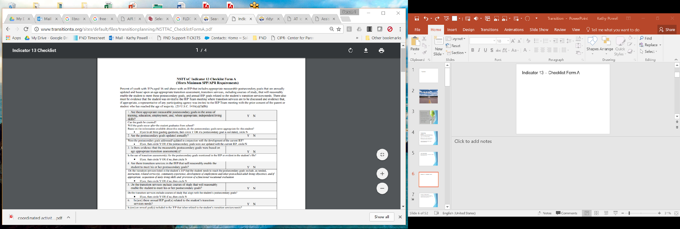
Indicator 13 – Checklist Form A
Indicator 13 Checklist A
Notes:
The United States Department of Education, Office of Special Education Programs requires states to submit data annually related to transition services as part of 20 State Performance Plan (SPP) indicators in the Annual Performance Report. (For example: Indicator 1: Graduation, Indicator 2: Dropout Rate, Indicator 14: Post-secondary Outcomes)
But we’ll be focused on Indicator 13: Post-secondary Goals- and that requires that every student with an IEP aged 16+ have a detailed transition plan. And it asks these questions:
Are there measurable postsecondary goals in the areas of training, education, employment, and where appropriate independent living skills?
Are the postsecondary goals updated annually?
Is there evidence the measurable postsecondary goals were based on age appropriate transition assessments?
Are there transition services in the IEP that will reasonably enable the student to meet his or her postsecondary goals?
Do the transition services include courses of study that will enable the student to meet his or her postsecondary goals?
Is (are) there annual IEP goal(s) included in the IEP that is/are related to the student’s transition service's needs?
Is there evidence the student was invited to the IEP meeting where transition services were discussed?
If appropriate, is there evidence that a representative of any participating agency was invited to the IEP Team meeting? (with prior consent of the parent or student who has reached the age of majority?)

Slide 5

Transition Age :
IDEA 2004 & Florida
Notes:
I’ll start by sharing that in IDEA 2004 (The Individual with Disability Education Act) and law ensuring services to children with disabilities
says IEPs must include transition services for a child by age sixteen (16), and update annually. (This provision changed from age fourteen in 1997 to now sixteen (16) in the new Improvement Act of 2004)
But in Florida, planning can begin when student turns the age of fourteen (14) if determined appropriate by the IEP Team. The notice must also indicate that a purpose of the meeting will be identifying transition services needs of the student and that the district will invite the student.
Sec. 614(d)(1)(A)(i)(VIII)
http://idea-b.ed.gov/explore/view/p/,root,regs,300,D,300.320,b,.html
Key Provisions on Transition
IDEA 1997 compared to H.R. 1350 (IDEA 2004)
http://www.ncset.org/publications/related/ideatransition.asp
RULE:6A-6.03028 Provision of Free Appropriate Public Education (FAPE) and Development of Individual Educational Plans for Students with Disabilities
https://www.flrules.org/Gateway/View_notice.asp?id=16930882

Slide 6

Postsecondary Education
Interagency Linkages
Student Services
Residential Placements
Notes:
Postsecondary Education
.
You’re going to need time for planning and accessing the support services needed in the future.
To start, school will need a statement of intent to pursue a standard high school diploma (as determined by parent)
Then there’s the preparation needed for the student to graduate from high school
standard diploma and
a Scholar or Merit diploma designation (as determined by parent)
And the consideration of the student’s need for instruction in:
in self-determination to assist the student to be able to actively and effectively participate in IEP meetings
and self-advocacy, so that needed postsecondary and career goals may be identified and in place by age sixteen (16).
Interagency Linkages
Services listed on an IEP that agencies have agreed to provide or help the school district provide.
Some students will likely be using the services of many agencies and time will be needed to figure out who can do what and who will pay for what.
Support Services /Residential Placements
Early and long-range planning are critical in order for the student to receive many post-school programs or services whether they include support services in college or residential services from an adult provider.
Students and families are often faced with much paperwork to meet eligibility requirements and some adult services have long waiting lists.

Slide 7

Transition Assessment
Employment
Education
Training
Independent Living
Picture of man working at a computer
Picture of husband, wife and son
Picture of student and teacher
Notes:
IDEA 2004 requires that appropriate measurable postsecondary goals be based upon age-appropriate transition assessments related to training and education, employment, and where appropriate, independent living skills.

Slide 8

Goals of Transition Assessment
Informed Choices
Take Charge of Transition Process
Understand Skills Needed for Post-School Environment
Notes:
Goals of Transition Assessment
Make informed choices
Take charge of the transition process
Understand the skills needed for post-school environments

Slide 9

Community Participation Assessments
Career Cluster Interest Inventory
Notes:
Community Participation Assessments
Goals, as needed, based on knowledge and demonstration of skills needed to participate in the community (e.g., tax forms, voter registration, social interactions, consumer activities, accessing and using various transportation modes.)
Student Participated in Career Clusters interest inventory
Identified Information Technology as field of interest
Discovered college courses are necessary to achieve desired career

Slide 10

Transition Sections of the IEP

Slide 11

Student Led IEP
Notes:
FND has a Student Led IEP workshop available
https://www.imdetermined.org/quick-links/student-involvement/
Example of blank copy (include slides)
Example of my daughter’s (include slides)
FND’s Transition Tool Kit:
(recognized on the Center for Parent Involvement’s website)
https://fndusa.org/resources/transition-tool-kit-2/
FND’s Youth Advocate -- Cateland Abernethy -- Cateland@fndfl.org
Works directly with the Youth to help them plan their transition goals

Slide 12

Present Levels of Academic & Functional Performance
Preferences
Strengths and Interests
Course of Study
Notes:
Present Levels of Academic and Functional Performance
Transition assessments are included in the PLEP to formulate strengths and needs.
Preferences, Strengths and Interests and Course of Study
These must be BASED ON Present Levels of Performance and Age Appropriate Transition Assessments
The course of study lists the classes, experience, and activities that are needed to assist the child in high school in preparation for reaching their post-secondary goals.
It should be directly related to the student’s post-secondary goals, be meaningful to the student’s future, motivate the student to complete his or her education, and support post-school outcomes.
When designing the course of study, pay attention to the entry requirements of colleges, career tech, or specific jobs.

Slide 13

Postsecondary Goals
  Where do I want to live, learn, and work after high school?
Notes:
Postsecondary Goals
Students of transition age must have further education and employment postsecondary goals
Independent living is optional
Students have input and write goals based on answers to the question:
Where do I want to live, learn, and work after high school?
Need to be updated annually

Slide 14
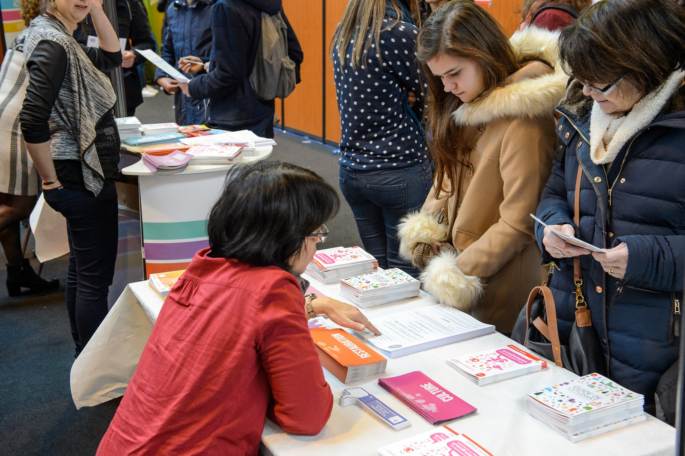
Vocational Educational Information
  Career Tech Programs
  Work Study
  Work Adjustment
  Community-Based Job Experiences
  High School to College
Notes:
Department of Vocational Rehabilitation Referral
A referral form for DRS must be completed and sent to DRS Office
Parents and students need to follow-up to ensure application process is complete
Co

Slide 15

Getting Ready for The Age of Majority
Notes:
Age of Majority happens whether you or your child is ready or not!!!
https://www.parentcenterhub.org/age-of-majority-parentguide/
Any questions on “Transfer of Rights”?
Download app “Just Adulting” …. For all your children who turn 18
Without Guardian Advocacy, your student is responsible for:
Providing consent to invite outside agencies to their IEP
Deciding whether or not they will continue their education beyond their H.S. Diploma
Any contract that they sign
Their health care needs and communication
Their Independent Living situations
Managing their Finances
Without Guardian Advocacy paperwork, the school MUST follow the student’s wishes….which includes leaving the school system.

Slide 16

Transfer of Rights
Notes:
Before students turn 17 years old, parents and students need to be told about the transfer of rights that will happen when upon 18.
Married students have the rights transferred regardless of age
Local educational agencies (LEAs) should inform parent(s) of their option to seek legal advice if they plan to continue making decisions for their child upon the child reaching the age of majority.
Do you have Guardianship?
Information must be provided, including
Career Tech programs
Work study
Work adjustment
Community-based job experiences
High school vocational ed classes
Some career tech programs are very selective and planning needs to take place so students can take the correct pre-requisite courses.
Parents are able to continue to Advocate for their child:
With VR--Vocational Rehabilitation
With APD--Agency for Persons with Disabilities
With the Medical, Dental & Surgical Profession
Plan for the doctor beyond the Pediatrician
In deciding where the person will live
As a Representative Payee of Government Benefits or apply for them
With many Colleges and Universities
https://info.fldoe.org/docushare/dsweb/Get/Document-2862/05-35.pdf

Slide 17

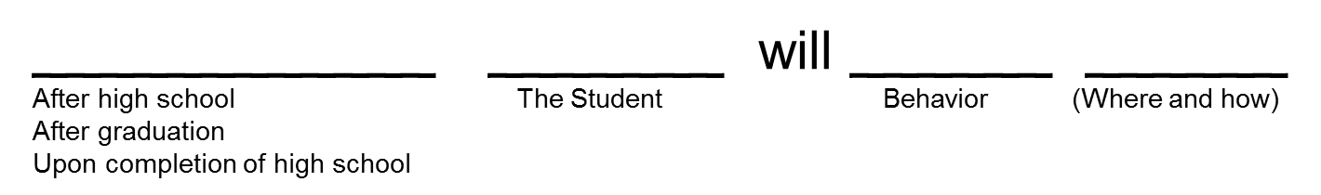
Where will Ryan WORK?
Where will Ryan LEARN?
Where will Ryan LIVE?
Notes:
Sample Postsecondary Goals
Where will Ryan WORK?
Where will Ryan LEARN?
Where will Ryan LIVE?
If you can answer these 3 questions, the postsecondary goal is compliant.

Slide 18
Transition Activities/Services
  Ryan
  Take the ASVAB
  Job shadow different positions at Tinker
  Visit Air Force recruiter
  Obtain driver’s license
  Learn Air Force vocabulary
  Build resume
  Practice interviewing skills
  Open a checking/savings account at local bank
  Isabel
  Get her food handler permit
  Job shadow at a local florist
  Visit local Career Tech
  Research entrepreneurship
  Learn keyboarding skills
  Open a checking/savings account at local bank

Slide 19

After graduation, Lucy will live at home and participate to the maximum extent possible in her daily routines, and she will volunteer at least once per week at the local childcare facility as she receives on the job training as a childcare worker.
Notes:
Sample Postsecondary Goals
Let’s reverse it now to see if this goal is written correctly…..
After graduation, Lucy will live at home and participate to the maximum extent possible in her daily routines, and she will volunteer at least once per week at the local childcare facility as she receives on the job training as a childcare worker.

Slide 20
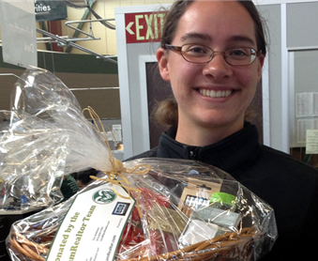
“Within three months of graduation, Debbie will participate in/audit business development courses at the local Career Tech school.
With the help of a Vocational Rehab (VR) Specialist, Debbie will implement her business plan for a home-based business of custom gift baskets.”
Notes:
Sample Postsecondary Goals
“Within three months of graduation, Debbie will participate in/audit business development courses at the local Career Tech school. With the help of a habilitation training specialist (HTS), Debbie will implement her business plan for a home-based business of custom gift baskets.”
Where will she work? Learn? Live?

Slide 21






Notes:
This slide represents our FND Family. These are the programs housed under Family Network on Disabilities. Each program provides a unique service to a specific population:
POPIN- provides parent training and information (PTI) services to the North Florida region from Escambia to Volusia County. (37 Counties)
(Escambia, Santa Rosa, Okaloosa, Walton, Calhoun, Gulf, Bay, Washington, Jackson, Liberty, Holmes, Franklin, Wakulla, Gadsden, Leon, Jefferson, Taylor, Madison, Hamilton, Dixie, Suwannee, Lafayette, Gilchrist, Columbia, Baker, Levy, Alachua, Union, Bradford, Nassau, Duval, St. John’s, Clay, Putnam, Flagler, Marion, & Volusia).
PSN- provides parent training and information (PTI) services to the Central Florida region. Our home office is in Clearwater, FL. (Brevard, Citrus, De Soto, Hardee, Hernando, Highlands, Hillsborough, Indian River, Lake, Manatee, Okeechobee, Orange, Osceola, Pasco, Pinellas, Polk, Sarasota, Seminole, St. Lucie, and Sumter)
PEN- for the ten most southern counties of Florida, (Charlotte, Lee, Collier, Hendry, Palm Beach, Broward, Miami-Dade, Monroe, Martin, and Glades).
Family Star- is the Family to Family Health Information Center (F2F HRC) of Florida and is funded by a grant from the U.S. Department of Health and Human Services (HHS), Health Resources and Services Administration (HRSA).
This program will assist families of Children and Youth with Special Health Care Needs (CYSHCN) to make informed decisions about health care for their children, providing:
Support, Training, Assistance, and Resources.
Dadvocates- is a network of dads that promotes the involvement of fathers in the lives of their children with disabilities. This program is intended to help provide father-to-father support throughout Florida. We can provide your group with specific workshop topics or you can just meet for:
Father-to-Father Networking
Community Outings
Information and Resources
Help with Personal Coping
Sense of Unity
FND Special Needs Trust- FND provides comprehensive special needs trust services, including service as a trustee, co-trustee, or trust administrator. We handle all types of special needs trusts, including pooled trusts. Family Network serves as trustee for the Family Network on Disabilities National Pooled Trust, proudly serving persons with disabilities since 1999. We also serve as administrators for several other pooled trusts, including FND’s Family Pooled Fund of third party trusts, as well as many individual special needs trusts.

Slide 22
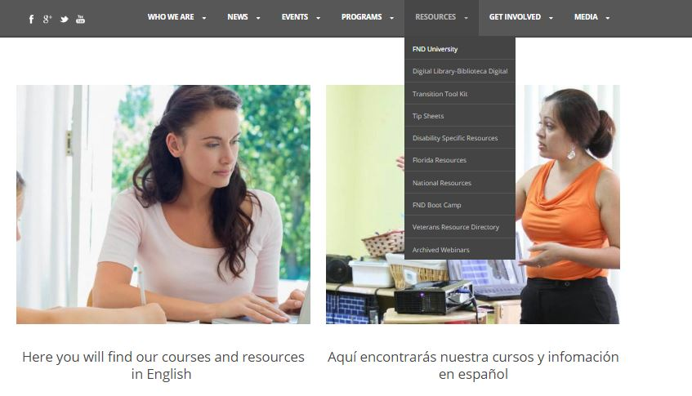
FND UNIVERSITY

Slide 23


The contents of this presentation were developed under a grant from the US Department of Education,
#H328M150041, #H328M150041, & #H328M150041
However, those contents do not necessarily represent the policy of the US Department of Education, and you should not assume endorsement by the federal government.
project Officer, David Emenheiser

Slide 24

Thank you!
For more information, please contact:
Family Network on Disabilities
The contents of this presentation were developed under a grant from the US Department of Education,
#H328M150041, #H328M150041, & #H328M150041
However, those contents do not necessarily represent the policy of the
US Department of Education, and you should not assume endorsement by the Federal Government.
Project Officer, David Emenheiser.
Family Network on Disabilities
2196 Main Street, Suite K
Dunedin, FL 34698
(727) 523-1130
(800) 825-5736
fnd@fndusa.org
www.fndusa.org
© 2018 Family Network on Disabilities of Florida, Inc.
Notes:
The contents of this presentation were developed under a grant from the US Department of Education,
#H328M150041, #H328M150041, & #H328M150041
However, those contents do not necessarily represent the policy of the
US Department of Education, and you should not assume endorsement by the Federal Government.
Project Officer, David Emenheiser.

