Slide 1
Everything You Need to Know About Florida’s Disability Savings Program
Notes:
Welcome! ​
​
Thank you to [organization name] for the opportunity to present today on ABLE United, Florida’s qualified ABLE program. My name is [Name], and I serve as an Ambassador in [location]. I am excited to share ABLE United 101, our overview of Florida’s disability savings program, which covers who it’s for, how it works, and its benefits. ​
​
Let’s get started.​

Slide 2

PRESENTATION OVERVIEW
ABLE Outline
History and Legislation
Program Management
ABLE Eligibility
ABLE Account
Public Benefits
Key Statistics
FAQs / Questions
Notes:
Here’s a quick snapshot of what we’ll cover today during our time together: ​​
​​
History and Legislation ​
ABLE Eligibility will help you identify who qualifies to have and manage these accounts​
​How to enroll and manage your account online​
How it Work with Public Benefits ​
And finally we’ll discuss some FAQs
​

Slide 3
History and Legislation
Federal and State
Notes:
Let’s start with a quick overview on the federal and state specific legislation

Slide 4
ABLE LEGISLATION
ABLE stands for “Achieving a Better Life Experience” –it was made possible by the passage of the ABLE Act in December 2014.
Florida passed Florida ABLE Act in July 2015.
Notes:
So, what is ABLE? ​
​
The Stephen Beck, Jr., Achieving a Better Life Experience (ABLE) Act, is a federal law that was enacted in December 2014, and authorizes each state to establish a program that offers tax-free savings and investment options to encourage individuals with a disability and their families to save private funds to support health, independence, and quality of life.
When the ABLE Act was passed, it added a new section to the Internal Revenue Code, Section 529 to include 529A – A for ABLE. Therefore, an ABLE United is often compared to a 529 College Savings Plan, as well as a checking and savings account and a Special Needs Trust. It has some similarities to each of these options – all rolled into one.

Slide 5
Notes:
In July 2015, the State of Florida created Florida ABLE, Inc. (d/b/a ABLE United) a registered not-for-profit and direct support organization of the Florida Prepaid College Board to administer the ABLE United Program.​​
​​
Our mission is to encourage and assist the saving of private funds to help persons with disabilities cover costs that support their health, independence and quality of life.​

Slide 6

PROGRAM MANGEMENT
Vestwell State Savings, LLC (d/b/a Sumday Administration), is ABLE United’s plan manager.
We collaborated with them to provide a secure online way to open and manage ABLE United accounts.
Vestwell is affiliated with some of the world’s largest financial institutions.

Slide 7
Eligibility
Who Qualifies / Who Can Manage
Notes:
Now that we’ve covered some of the basics on how ABLE came to be, let’s discuss who is eligible for an ABLE account.

Slide 8



ELIGIBILITY
Florida Resident
Onset prior to age 46
Severity of diagnosis
Unique to ABLE United as being a program run by the State of Florida – our focus is on making this the best option for Floridians.
Doesn’t matter current age, but diagnosis onset prior to age 46.
Currently receiving Supplemental Security Income, Social Security Disability Insurance or self-certify that individual has a diagnosis of a physical or mental impairment with marked and severe functional limitations.
Notes:
Eligible individuals must meet three eligibility requirements:​
​
First, the individual with a disability must be a Florida resident at the time of enrollment. ​
Second, the individual’s disability had to have an onset prior to age 26.​
And third, the individual must be receiving SSI or SSDI and have a disability that is marked as “severe”​
Those not receiving SSI or SSDI, then self-certify is an option, and that individual must: ​
​
Have a diagnosis of a physical or mental impairment prior to age 26​
Have a disability that is “marked and severe with functional limitations”​
Have a disability expected to last for at least 12 months​
​

Slide 9
DIAGNOSIS / DISABILITY SEVERITY
A qualifying disability includes individuals with a diagnosis such as:
Developmental Disorders: Autistic Spectrum Disorder, Asperger’s Disorder, developmental delays and learning disabilities
Intellectual Disability: Mild, moderate, or severe intellectual disability
Psychiatric Disorders: Schizophrenia, Major depressive disorder, Post-Traumatic Stress Disorder (PTSD), Anorexia Nervosa, Attention Deficit/Hyperactivity Disorder (AD/HD), Bipolar Disorder
Nervous Disorders: Blindness, Deafness, Cerebral Palsy, Muscular Dystrophy, Spina Bifida, Juvenile-onset Huntington’s Disease, Multiple Sclerosis, Severe sensorineural hearing loss, Congenital cataracts
Congenital Anomalies: Chromosomal abnormalities, including Down Syndrome, Osteogenesis Imperfecta, Xeroderma Pigmentosum, Spinal muscular atrophy, Fragile X Syndrome, Edwards Syndrome
Respiratory Disorders: Cystic Fibrosis
Other: Tetralogy of Fallot, Hypoplastic left heart syndrome, End-stage liver disease, Juvenile-onset rheumatoid arthritis, Sickle cell disease, Hemophilia, and any other disability not listed
Notes:
​
Ultimately, a qualifying disability is everything you see here – and it includes individuals with a diagnosis such as Down syndrome, autism, cerebral palsy, cognitive, developmental or mental health disorders. ​
​
It’s important to note that ABLE United does not assess if a person has a severe disability, but that it would be up to the IRS if they were to audit an individual.​
​
If an individual is unsure if their disability qualifies, we recommend utilizing our online eligibility wizard or you can download our physician form to obtain a disability diagnosis certification from a licensed health care provider.

Slide 10


OWNERSHIP
Ownership
Management
The individual with a disability, or the beneficiary, is the owner of the ABLE account and can manage their account if capable. However, they may choose someone to have authorized signatory of their account.
Another person may have authorized signatory over the ABLE account such as:
Legal Guardian
Power of Attorney
Parent, Spouse, Sibling, Grandparent
Social Security Representative Payee (Individual or Organization)
This authorized signatory is commonly referred to as the Authorized Legal Representative (ALR).
Notes:
Here’s one of our key benefits. ​
​
When it comes to ownership, it’s important to note that unlike some other savings and investment options, the individual with the disability is the owner of the ABLE account – however, another person can help in opening and/or maintaining the account.​
​
For a beneficiary who is over the age of 18, an Authorized Legal Representative or ALR can also help set up or maintain an account. An ALR is someone who is legally authorized under state and federal law to make decisions for the Beneficiary – if that is the case, additional paperwork will be required. ​
​
Recent IRS regulations have expanded who can serve in this role to a power of attorney, conservator or legal guardian, the spouse, a parent, a sibling, a grandparent, or a representative payee (whether an individual or organization) appointed by the Social Security Administration (SSA), in that order.

Slide 11
ABLE Account
Enrollment, Account Management, Contributions, Savings/Investments, and Distributions
Notes:
Next - let's talk a little bit about the enrollment process and how an account works. ​​

Slide 12
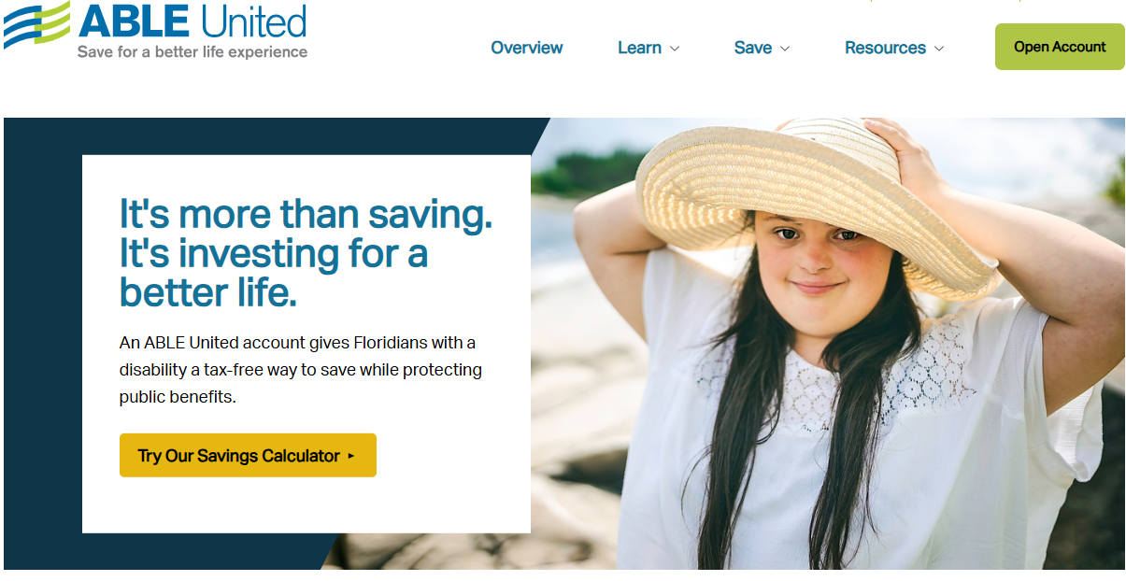
ENROLLMENT
www.ableunited.com
Notes:
Enrolling and managing an ABLE United account is all done online at ableunited.com – no need to go to the bank to setup an account. Signing up is quick, easy and free – it only takes 15 minutes or less. ​
​

Slide 13
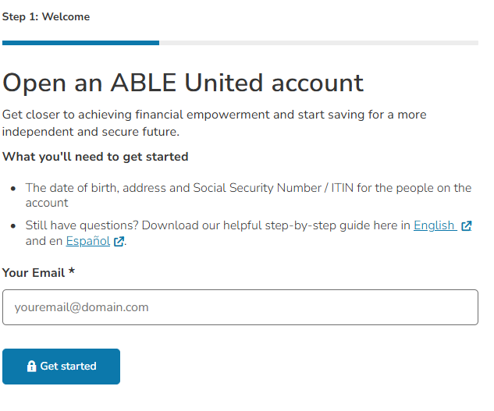
OPENING AN ACCOUNT
What you need to get started
Email Address
Date of Birth, address and SSN for beneficiary and ALR
Eligibility requirements
Contribute $25
Investment Selection
Notes:
Since this is a financial product, we will require some personal identification information. ​
​
Here’s what’s needed: ​
​
An email address​
The date of birth, address and Social Security Number for the individuals on the account ​
Self-certification if opening on behalf of Beneficiary​
Banking information ​
Minimum $25 contribution to the account (but there is no monthly minimum contributions required once the account is opened)​
Investment selections

Slide 14
CONTRIBUTIONS
Anyone can contribute to an ABLE Account.
Generally, contributions are considered gifts (not income) to the individual with a disability.
A total of $20,000 per calendar year – max account balance $500,000
Rollover over 529 college savings plan.
Can contribute leftover SSA funds – additional rules
Income contributed to account still counts as income
ABLE to Work contribute above $20,000 limit – additional $15,060 in 2026.
Notes:
After an account is opened, individuals can contribute what they can, when they can! The best part is, you can also save with the help of friends, family or even an organization, such as a church – up to $19,000 from all sources, per calendar year. ​
​
There is one exception – and that is if an individual is working. ​
​
Through ABLE to Work, beneficiaries who are working and not currently saving for retirement to contribute above $19,000 – that amount is equal to the poverty line for a one-person household, as determined for the calendar year preceding the calendar year in which the taxable year begins. This year, in Florida that total is $15,060, which allows an individual to save up to $34,060.​
​
Individuals also have the opportunity to contribute to an ABLE account through the rollover of funds from 529 savings plans.​
​
Lastly, there is no federal income tax-deduction for contributing to an ABLE account, so individuals can’t write contributions to your ABLE account off as a donation. Contributions are considered completed gifts and not income to the individual. Unless the individual is putting in their earned income or if it some kind of unearned income like child support. ​

Slide 15
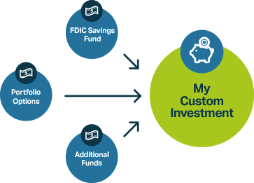

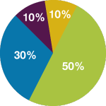
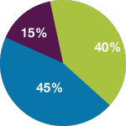
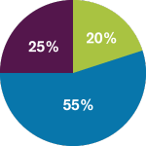
INVESTMENT AND SAVINGS OPTIONS
FDIC Savings
Fund
Predesigned Portfolio Options
Additional Funds
Money Market Fund – Florida Prime
U.S. Bond Fund - Vanguard
U.S. Stock Fund - Vanguard
Conservative
Moderate
Growth
International Stock Fund - BlackRock
Notes:
So, we’ve explained how individuals can get money into an account, let’s discuss now where that money can go. ​
ABLE accounts are unique as it is a savings and investment tool. ​
The next part of the account setup process is the selection of investments. ​
​
ABLE United currently offers eight investment options, ranging from conservative to aggressive, including three predesigned portfolio options, which you see here.​
​
We also have five fund options, including:​
​
Money Market;​
U.S. Bond Fund;​
U.S. Stock Fund; ​
International Stock Fund; ​
And, our newest offering, which is the FDIC Savings option.​
​
The FDIC Savings Option is an alternative to investing. Assets up to $250,000 are protected and insured, but keep in mind that with a low level of risk, there’s also a lower level of returns. ​
​
When it comes to investments, you can change how incoming contributions are invested at anytime and as frequent as you want. However, funds already invested in the program can only be rebalanced, or reinvested, twice a year. All of our performance information is available online at ableunited.com. ​

Slide 16
DISTRIBUTIONS
ACH / Prepaid Card
2 – 3 Business Days
Check request
5 – 7 Business Days
For fastest access to funds, request a withdraw via ACH to a connected bank account or Prepaid Card. THIS IS NOT A BANK ACCOUNT.
Online can preview check, select previous vendors, and add information on memo line.
Individuals can have multiple bank accounts tied to account; must belong to ALR or Beneficiary.
The ABLE Visa® Prepaid Card is issued by Sunrise Banks N.A., St. Paul, MN 55103, Member FDIC, pursuant to a license from Visa U.S.A. Inc. This card can be used everywhere Visa debit cards are accepted. Use of this card constitutes acceptance of the terms and conditions stated in the Cardholder Agreement.
Can be sent to ALR, Beneficiary or third-party.
Dependent on the USPS; option for overnight mail.
Either way, choose funds to withdraw from. Earnings are tax-free if used for Qualified Disability Expenses.
Recommend keeping documentation for IRS/SSA
Notes:
One of the best things about having an ABLE United account is its flexibility – money can be withdrawn from an account at any time, for any reason. ​
​
There are two main ways of getting money out of your ABLE United account, one is sending it back to the connected bank account. When you create an account, you will be connecting a bank account, and you are able to add more than one account if parents or family members want to contribute more regularly. This ACH electronic transfer does take 2-3 business days. There is also the ABLE Visa® Prepaid Card, but accessing those funds also takes 2-3 business days. ​
​
The other way to withdraw from your ABLE account is to request a check be mailed, they can take a little longer, 5 – 7 business days. ​
​
A few additional considerations: ​
​
If the money in an ABLE United account is spent on Qualified Disability Expenses, as defined by federal law, the earnings on the money withdrawn are tax-free. ​
​
You have the opportunity to choose which investment to withdraw from, which allows you to separate your savings from your investing. ​
​
If asked by the IRS or Social Security Administration, for those receiving SSI, the Beneficiary or Authorized Legal Representative is responsible for providing receipts for Qualified Disability Expenses. We always recommend that the individual or the person who is administratively responsible for the account keep necessary documentation on hand, so if asked, they could show that the expense relates to the person’s disability and helps improve their health, independence or quality of life. ​
​
Please note that contributions made by the Authorized Legal Representative or Beneficiary within the past 5 business days or gift contributions received within the past 10 business days will not be available for withdrawal.​

Slide 17
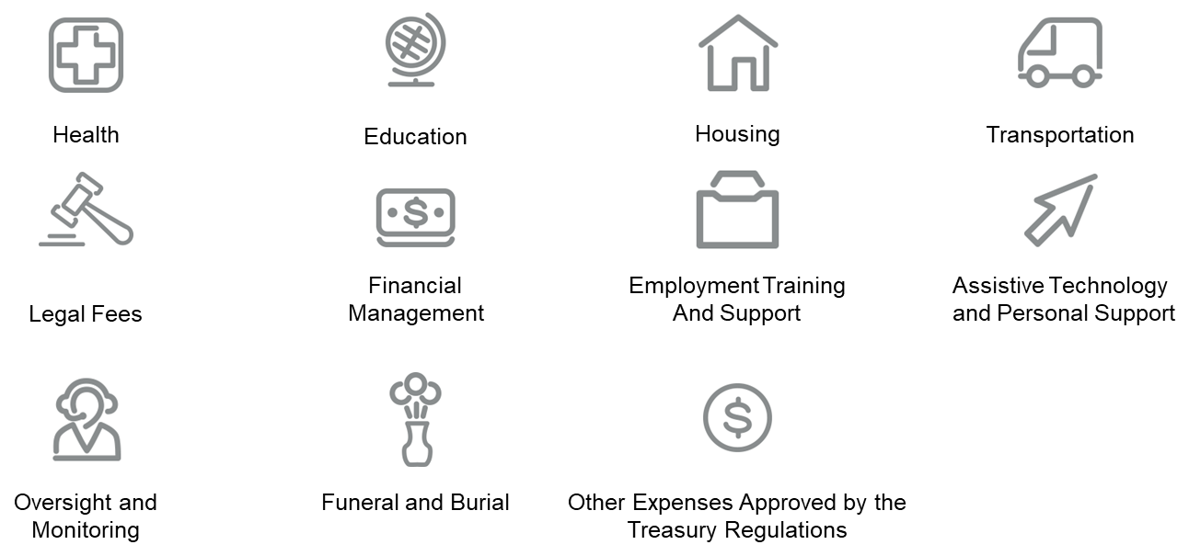
QUALIFIED DISABILITY EXPENSE (QDE)
Notes:
So, what are qualified disability expenses? ​
​
Some of these expenses include health, education, housing, transportation, legal fees, financial management, employment training and support, assistive technology and personal support services, oversight and monitoring, funeral and burial, and other expenses approved by Treasury regulations.​
​
We’ll quickly run through a few examples now. ​

Slide 18

FEES
Best Value for Floridians
Free to enroll – no application fee, monthly maintenance fee or check request fee.
Investment administration fee ranges from 0% to 0.29% annualized (up to $2.90 per $1,000 each year)
Optional fees include paper statements ($20) and Prepaid Card $2.50 per month.
Notes:
Now, let’s move on to costs associated with opening and managing an account. We get asked this question a lot – and the answer is that it’s free. ​
​
There is no:​
​
Application fee​
Account maintenance fee​
​
All you have to do is to put in a minimum contribution of $25 to get started and let your money make money for you. ​
​
There are some optional fees associated with paper statements, the prepaid card and investment administration fees that range from 0 to .29 percent annually. ​
​
We are proud to provide the best value for Floridians and are one if not the only program that has no fees associated with opening and managing an account. ​

Slide 19
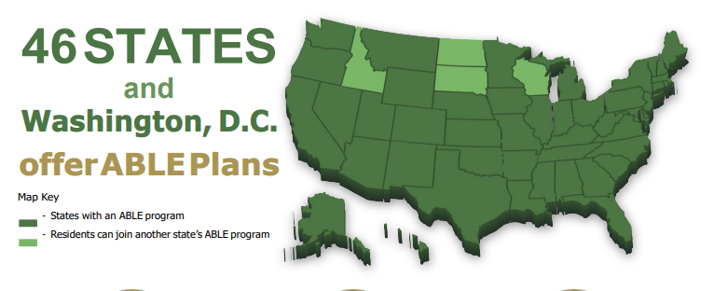
ABLE PROGRAMS NATIONWIDE
ABLE National Resource Center: www.ablenrc.org

Slide 20
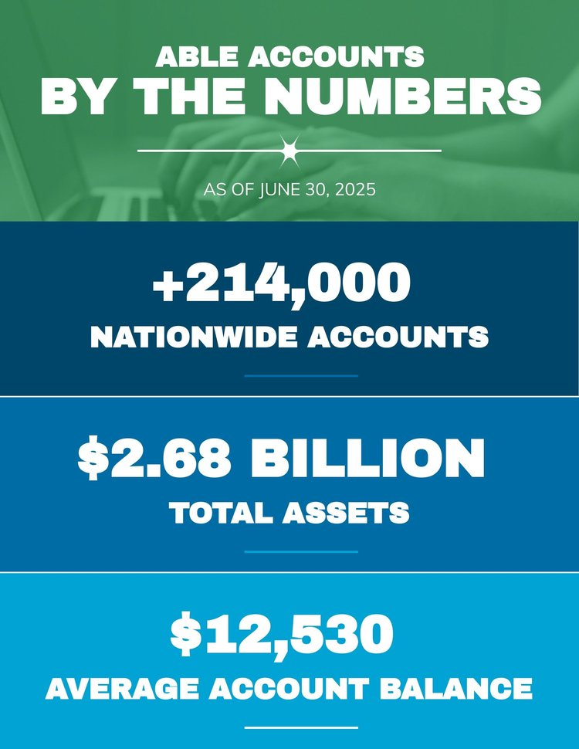
ABLE ACCOUNTS NATIONALLY AND FLORIDA
ABLE United | Sep 2025
Accounts | 14,052
Assets Under Management | $139 Million
Average Account Balance >$0 | +$11,325

Slide 21
Public Benefits
Notes:
Now let’s pivot and talk about the specifics on how an ABLE account works with public benefits.

Slide 22
SUPPLEMENTAL SECURITY INCOME (SSI) AND MEDICAID
Medicaid helps with medical costs for some people with limited income and resources.
SSI is a Federal supplement program that provides cash to meet basic housing needs.
Generally, funds in (or withdrawn from) an ABLE account are disregarded as a resource when determining eligibility.
For SSI Purposes the first $100,000 in an ABLE Account does not count as a resource (typically a $2,000 limit)
Housing and non-qualified expenses withdrawn and not spent by end of month may count as a resource in the next month - avoid by having ABLE pay directly
If Representative Payee assigned, SSA requests they be the one to manage the ABLE Account if SSA funds are being deposited
For more information, review the Social Security Program Operations Manual System (POMS) http://policy.ssa.gov/poms.nsf/lnx/0501130740
Recent Florida law states Medicaid may not file a claim on an ABLE account.
Typically, after all outstanding qualified disability expenses have been paid, leftover funds go to the beneficiary’s estate.
Notes:
The main two programs that our account holders use are SSI and Medicaid.
Medicaid is a federal and state program that helps with medical costs for some people with limited income and resources. ​
​
Supplemental Security Income (SSI) is a Federal supplement program that provides cash to meet basic needs for housing. ​
​
Like Medicaid, SSI has a resource limit of $2,000 and generally, funds in, or withdrawn from, an ABLE account are disregarded as a resource when determining eligibility. ​
One important thing to note is that in June 2019, the Florida Legislature clarified that the Florida Medicaid program may not file a claim for Medicaid recovery of funds in an ABLE United account. Now, upon the death of a designated Beneficiary, funds in the ABLE account must first be distributed for Qualified Disability Expenses, then transferred to the estate of the designated Beneficiary.
But I will share that Medicaid Estate Recovery does exist for those 55 and over – and meet other types of qualifiers.
​
It’s important to know that when it comes to ABLE accounts, individuals receiving SSI are able to save a total of $100,000 before it counts as a resource. For those not on SSI, there is a maximum balance of for each ABLE United Account. $500,000 ​
​
All housing and non-qualified expenses withdrawn, but not spent in the same month, count as a resource​
​
Earned/unearned income directly deposited into an ABLE Account still counts as earnings and may reduce SSI benefits.​
​
The social security administration has a program operations manual system, also known as POMS, that they use to describe how social security should handle ABLE accounts – if you or your loved one are receiving these benefits, we recommend you review the manual. ​

Slide 23

SSI EXAMPLE - HOUSING
Amy takes a distribution of $500 from her ABLE account in May to pay a housing expense for June. She deposits the $500 into her checking account in May, withdraws $500 in cash on June 3, and pays her landlord.
This distribution is a housing expense and part of her checking account balance as of June 1, which makes it a countable resource for the month of June.
Avoid In-Kind Support and Maintenance Reduction by having ABLE account pay housing directly or withdrawal and pay housing in same month
Notes:
LEAD: JOHN
On the topic of SSI, it’s important to know that all housing and non-qualified expenses withdrawn, but not spent in the same month, count as a resource.
Let’s walk through an example:
Amy takes a distribution of $500 from her ABLE account in May to pay a housing expense for June. She deposits the $500 into her checking account in May, withdraws $500 in cash on June 3, and pays her landlord.
This distribution is a housing expense and part of her checking account balance as of June 1, which makes it a countable resource for the month of June.
For individuals looking for a bit of a workaround, we recommend setting up the ABLE account to pay housing directly or simply withdrawal and pay housing same month.

Slide 24
OTHER FEDERALLY MEANS TESTED PROGRAMS
Centers for Medicare & Medicaid Services
Supplemental Nutrition Assistance Program (SNAP)
United States Department of Housing and Urban Development
Free Application for Federal Student Aid (FAFSA)
Released letter confirming “…. Funds in an ABLE account, including earnings on the account (e.g., interest), be disregarded in determining eligibility for Medicaid and other federal need-based programs.”
Left Medicaid recovery up to states “If the estate of an ABLE account beneficiary is not subject to Medicaid estate recovery, states have discretion whether to file a section 529A claim against the ABLE account of a deceased individual who had been enrolled in a Medicaid Buy In program.”
SNAP is a means-tested Federal program, the Food and Nutrition Service (FNS) has determined that funds in ABLE accounts should be excluded as both income and resources in determining SNAP eligibility based on this provision.
Notice PIH 2019-09: Treatment of ABLE Accounts in HUD-Assisted Programs states: Per the mandate of the ABLE Act, for the purpose of determining eligibility and continued occupancy, HUD will disregard amounts in the designated beneficiary’s/individual’s ABLE account.
FAQ’s state investments don’t include ABLE accounts. (https://studentaid.gov/2526/help/current-net-worth)
Notes:
LEAD: JOHN
First up – Medicaid, which we covered earlier, but two things to note:
Centers for Medicare & Medicaid Services released a letter confirm that funds in an ABLE account, including earnings on the account will be disregarded in determining eligibility for Medicaid and other federal need-based programs.
They also further clarified on Medicaid recovery and, ultimately, let that up to the states to decide.

Slide 25
FAQs
Frequently Asked Questions and Q&A

Slide 26
FREQUENTLY ASKED QUESTIONS (FAQS)
What happens if beneficiary passes?
What happens if I move out of state?
Is “this” or “that” a Qualified Disability Expense?
Typically, all outstanding QDEs are paid first and then the remaining funds are distributed to the estate of the beneficiary.
You must be a resident of Florida at the time you enroll. After feel free to take the ABLE United account with you to your new state.
Ultimately, the Internal Revenue Service would determine if an expense is qualified or not.
Estate may be subject to Medicaid Recovery if over 55.
Could be distributed to sibling who qualifies for ABLE.
Goal is to use the funds to Achieve a Beter Life Experience.
SSA may ask what the funds may be used for if withdrawn and not spent in the same month.
Qualified expense include basic living expenses.
Improve or maintain health, independence, or qualify of life.
Some states may offer unique benefits – such as tax credits.
Other programs may have a checking option that may be better suited for your needs.

Slide 27
SNT VS. ABLE
Special Needs Trusts
ABLE Accounts
Established by Attorney / Trustee provides oversight
Established by Individual or Third party online
Can be used to fund ABLE accounts, depends on trust documents
Part of estate planning
Can accept non-cash assets such as life insurance, homes and other assets
Ranges in cost
Flexible – can be used to pay for food and shelter for SSI recipient without impacting benefits (no ISM reduction)
Grows tax-free
Restricted to $19,000 in contributions per calendar year
Protection against creditors
Free to enroll

Slide 28
Death of Beneficiary
Notes:
LEAD: JOHN

Slide 29
Section 1009.986(7), Florida Statute
(7) MEDICAID RECOVERY; PRIORITY OF DISTRIBUTIONS.—
(a) Unless prohibited by federal law, upon the death of a designated beneficiary, funds in the ABLE account must first be distributed for qualified disability expenses then transferred to the estate of the designated beneficiary or an ABLE account of another eligible individual specified by the designated beneficiary or by the estate of the designated beneficiary.
(b) Except as required by federal law, the state Medicaid program may not file a claim for Medicaid recovery of funds in an ABLE account.
(c) Florida ABLE, Inc., shall assist and cooperate with the Agency for Health Care Administration and Medicaid programs in other states by providing the agency and programs with the information needed to accomplish the purpose and objective of this subsection.

Slide 30
Final Regulations – Successor Designated Beneficiary
The Treasury Department and the IRS recognize the difficulties faced by the family, friends, and caregivers of a designated beneficiary at the end of the designated beneficiary's life. In order to alleviate some of these difficulties, the final regulations allow a qualified ABLE program to permit a successor designated beneficiary to be named during the lifetime of the designated beneficiary that will take effect upon the death of the designated beneficiary. The designation must be made before the designated beneficiary's death. If no successor designated beneficiary is named, the assets in the ABLE account are payable to the estate of the deceased designated beneficiary. Before any transfer to the successor designated beneficiary, however, the ABLE account is subject to the Federal estate tax imposed by chapter 11 of the Code upon the estate of the deceased designated beneficiary, as well as to the payment of any outstanding qualified disability expenses of the decedent and any State claim under section 529A(f).
https://www.federalregister.gov/d/2020-22144/p-172

Slide 31
CURRENT PRACTICE
Account continues to operate as normal until the Program is notified about a death of beneficiary; once notified, the account is frozen to prevent contributions
If the ABLE account currently has an Authorized Legal Representative:
  Funds may be requested to withdrawn to pay for outstanding qualified disability expenses including funeral/burial, outstanding bills including housing, credit card bills, etc.
  If funds remain, “a Certification will be required stating that the person is: (1) the executor of the Beneficiary’s estate as defined in Section 2203 of the Code; and (2) responsible for the proper disposition of the Account Balance” – ABLE Terms & Conditions Section 8.02 (d)
  May rollover these funds to a successor designated beneficiary (a sibling who also qualified for ABLE), however, before any transfer to the successor designated beneficiary, the ABLE account is subject to the Federal estate tax imposed by chapter 11 of the Code upon the estate of the deceased designated beneficiary, as well as to the payment of any outstanding qualified disability expenses of the decedent and any State claim (such as Medicaid)

Slide 32
CURRENT PRACTICE
If the ABLE account does not have an Authorized Legal Representative:
  Typically, a death of beneficiary form with death certificate and documentation on who is serving as the personal representative of deceased beneficiary’s estate is required
    Personal representative may use funds to pay outstanding qualified disability expenses
  If funds remain, “a Certification will be required stating that the person is: (1) the executor (personal representative) of the Beneficiary’s estate as defined in Section 2203 of the Code; and (2) responsible for the proper disposition of the Account Balance” – ABLE Terms & Conditions Section 8.02 (d)
  May rollover these funds to a successor designated beneficiary (a sibling who also qualified for ABLE), however, before any transfer to the successor designated beneficiary, the ABLE account is subject to the Federal estate tax imposed by chapter 11 of the Code upon the estate of the deceased designated beneficiary, as well as to the payment of any outstanding qualified disability expenses of the decedent and any State claim (such as Medicaid)

Slide 33
Federal Update
ENABLE Act
ABLE Employment Flexibility Act
ABLE Awareness Act

Slide 34
ABLE FEDERAL LEGISLATION
Ensuring Nationwide Access to a Better Life Experience (“ENABLE”) Act (S 4539; HR 9614)
ABLE Employment Flexibility Act (S 4911)
ABLE Awareness Act (S 4910)
Removes the sunset clause on the ABLE to Work Act and the ABLE Financial Planning Act.
This bill permits employers to make tax-exempt contributions to ABLE accounts in lieu of making contributions to existing tax-exempt defined contribution retirement plans.
Would require federal agencies to integrate information about ABLE into programs that serve eligible ABLE participants. Also, would provide grants to help promote and educate individuals about ABLE.
Increases ABLE contribution limits for employed account owners
Makes ABLE contributions eligible for the Saver’s Credit
Permits tax-free rollovers from 529 education savings accounts to ABLE Accounts. These provisions will be sunset on December 31, 2025.

Slide 35
Hypothetical Situations
Notes:
LEAD: JOHN
Before I open it up to questions, I want to spend a few minutes covering some of our frequently asked questions.

Slide 36
Mom receives full custody of 8-year-old with Autistic Spectrum Disorder. Court ruled dad must pay monthly child support services.
ABLE Account could receive up to $1,333 a month into ABLE account with mom accessing the funds directly without having to go through a pooled trust or trustee. Note, although payment may be direct-deposited into an ABLE Account, these funds still would be counted as income for SSI purposes.
ABLE Accounts shelter assets not income.
Notes:
John: Record keeping purposes for the most part. Only issue if someone receives two 5498s

Slide 37
Mom and dad have a child with a severe intellectual disability and split custody between them. Dad resides in Pennsylvania and Mom resides in Florida. They would like to open an ABLE Account for their child. Which ABLE program is best suited for the family?
It is important to note each state may establish an ABLE Program. ABLE United is the state of Florida’s ABLE Program. Pennsylvania’s ABLE Program, PA ABLE, has state income tax incentives for contributing to a PA ABLE account. However, an individual may only have one ABLE account nationwide regardless of which program is chosen.
PA ABLE is open for nation wide enrollment, while ABLE United is restricted to Florida residents at time of application. It may be best to point individuals to national organizations to help identify what program is best suited for their unique needs, such as www.abletoday.org.
Notes:
John: Record keeping purposes for the most part. Only issue if someone receives two 5498s

Slide 38

CONTACT US
Connect with Us
Visit us at ableunited.com/contact
Spanish resources available at ableunited.com/espanol
Customer Service
  1-888-524-2253,
  Monday – Friday 9 am to 6 pm ET
Notes:
There are several ways to reach us – including: ​
​
Online at ableunited.com – and for Spanish speakers, we just recently launched our Spanish landing page with downloadable resources. ​
Individuals can book a 1:1 conversation, via GoToMeeting, with an ABLE United team member for 15 minutes. All you have to do is visit our Events tab to see availability and book a time that works best by registering on the Calendly website. ​
We also have a chat function on our website, all you have to do is look for the icon on the bottom right of our homepage. ​
You can also reach us by phone to connect with a Customer Service Representative, Monday through Friday from 9am – 6pm ET

Slide 39
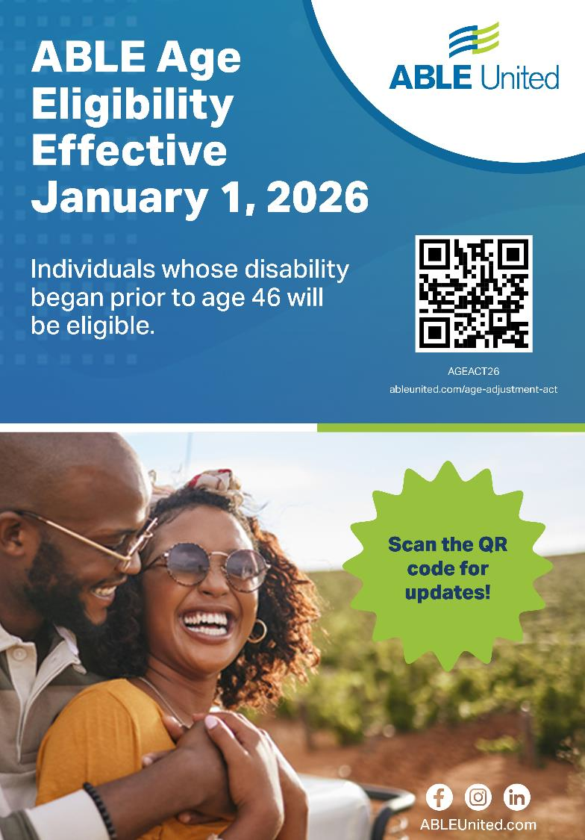
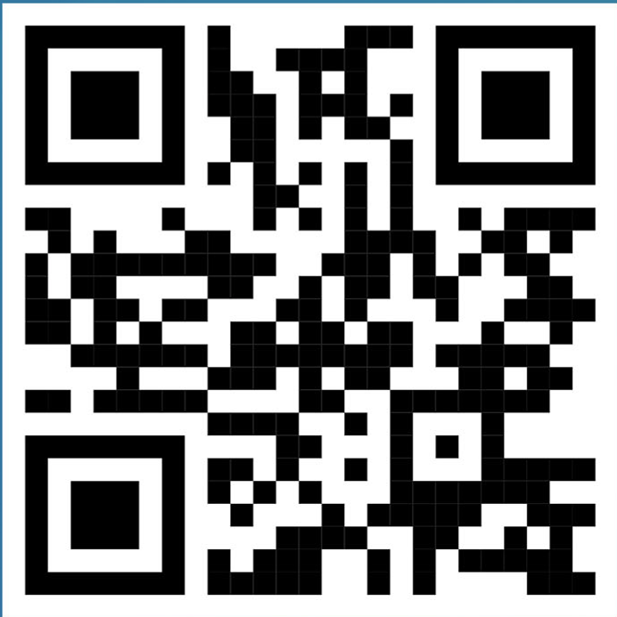
CONTACT US
Join our mailing list
Notes:
There are several ways to reach us – including: ​
​
Online at ableunited.com – and for Spanish speakers, we just recently launched our Spanish landing page with downloadable resources. ​
Individuals can book a 1:1 conversation, via GoToMeeting, with an ABLE United team member for 15 minutes. All you have to do is visit our Events tab to see availability and book a time that works best by registering on the Calendly website. ​
We also have a chat function on our website, all you have to do is look for the icon on the bottom right of our homepage. ​
You can also reach us by phone to connect with a Customer Service Representative, Monday through Friday from 9am – 6pm ET

Slide 40


June 12-14, Hyatt Regency Orlando
Workshops on topics related to special needs
Free for individuals & their families
Exhibit hall with vendors from state agencies & organizations
More info: familycafe.net
Saturday, April 25 UCF campus
Guardianship & the alternatives
SSI & APD updates
Special Needs trusts
Davey Law Group or Down Syndrome Association of Central Florida for more info.

Slide 41
Thank you!

