Slide 1
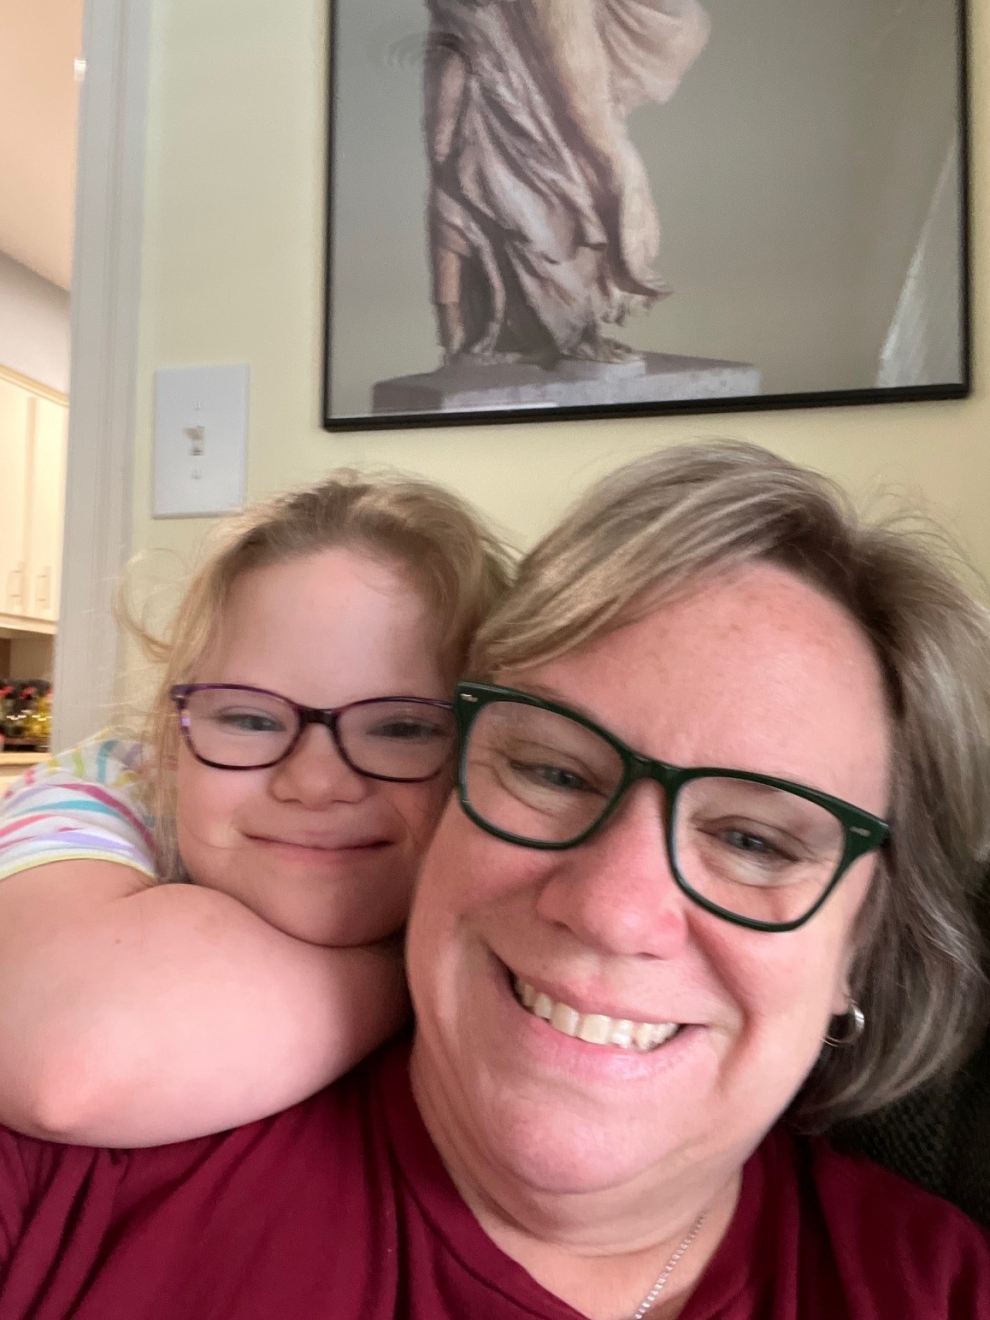
Guardianship, Guardian Advocacy and the Alternatives
  Catherine E. Davey, J.D., LL.M., Davey Law Group, P.A.
Notes:
Explain the session format with a brief overview.
Make sure handouts are distributed.
Let folks know to hold questions till the end.

Slide 2
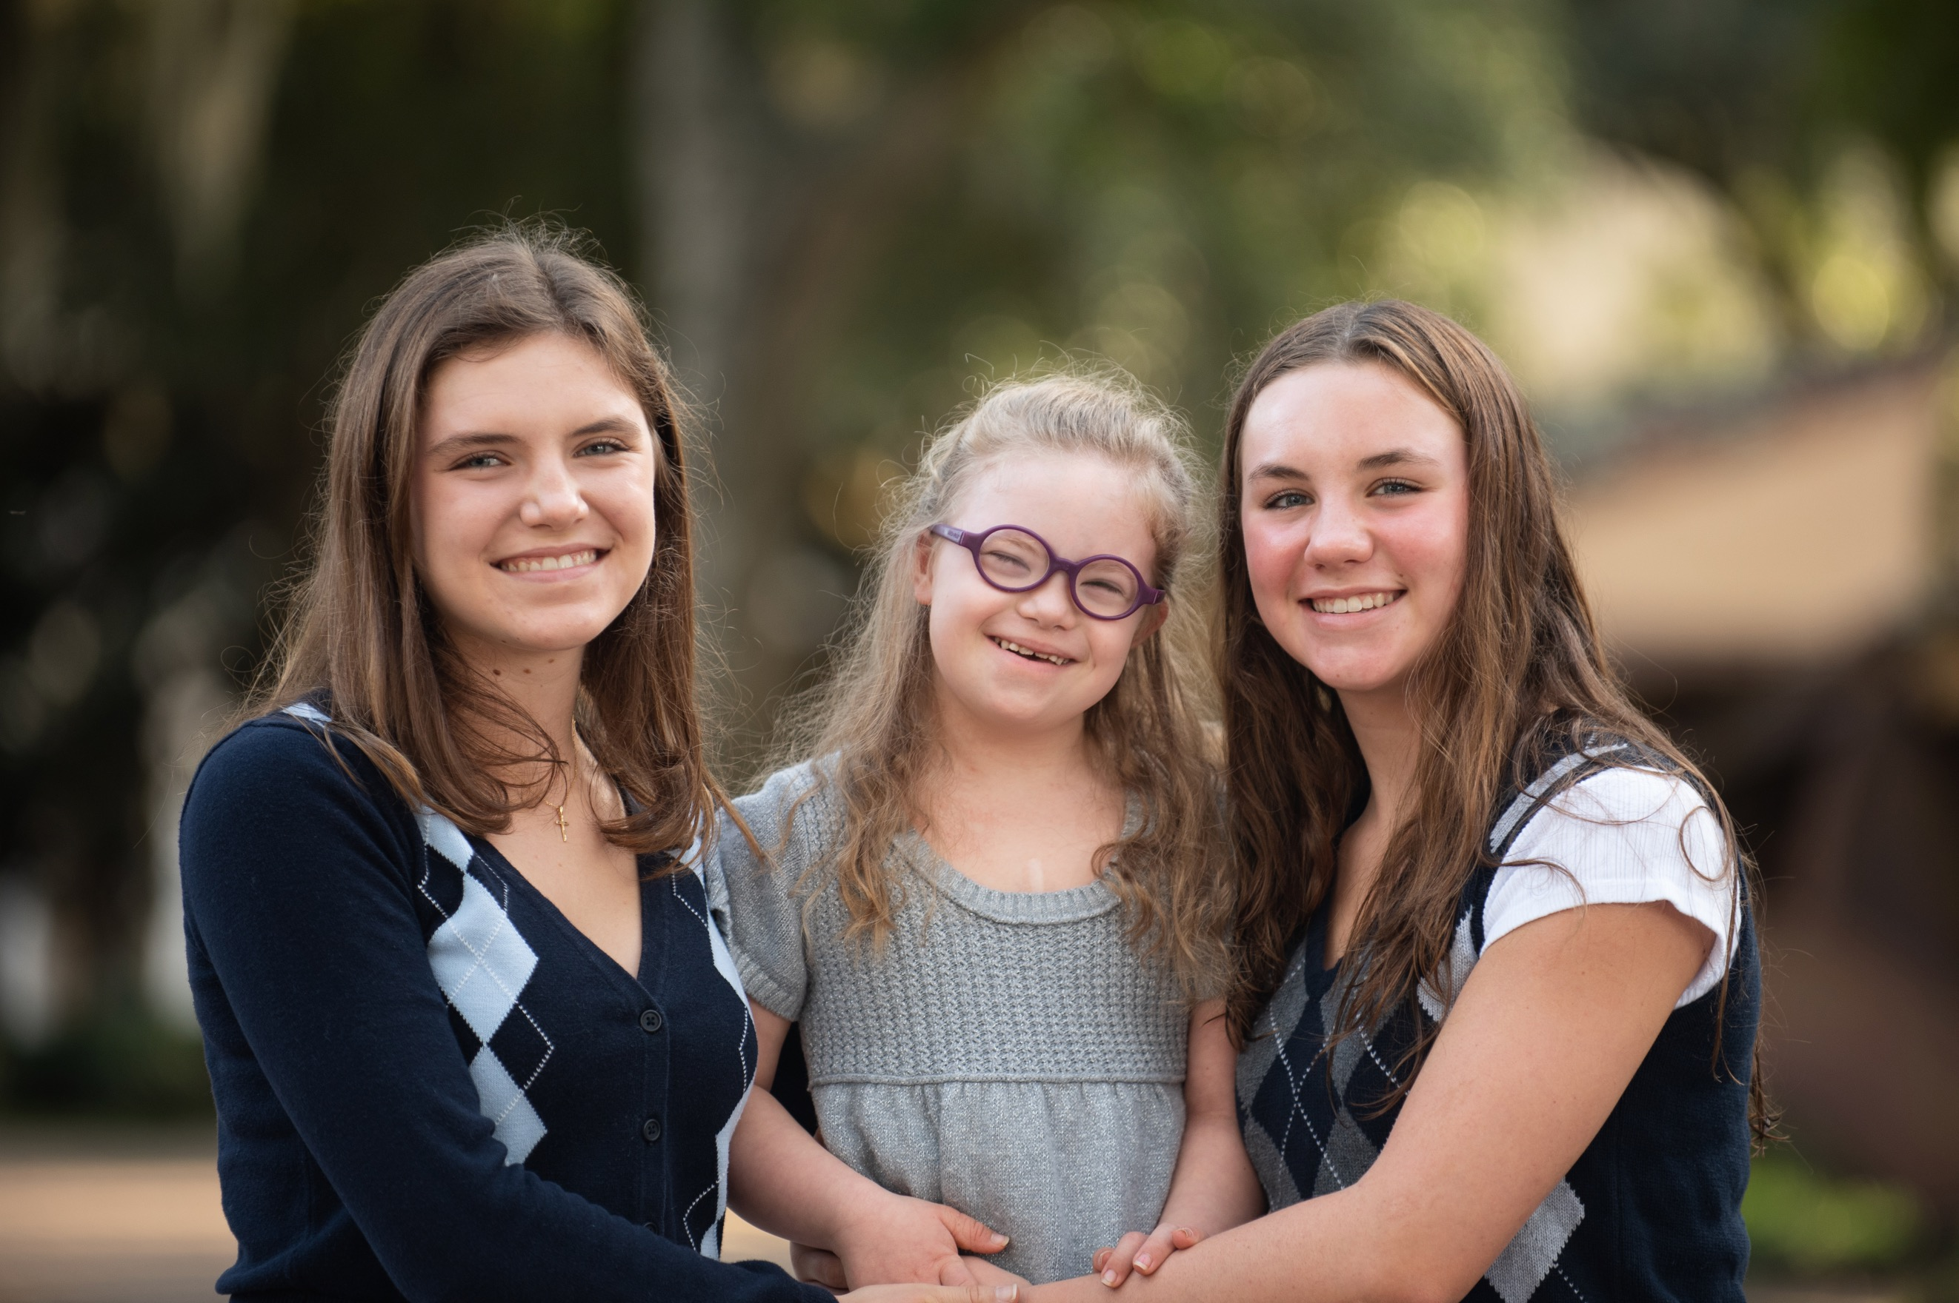
Agenda
Overview
People first language
Alternatives to Guardianship
  Supported/Shared Decision Making
  Substituted Decision Making
Guardian Advocacy
Guardianship
Next Steps and what else do they need to know?
Resources
Disclaimer: This presentation is intended for educational purposes only and does not constitute legal advice. Catherine Davey is not acting as your attorney and does not represent you in any legal capacity.
Notes:
Briefly review the agenda for the session

Slide 3
Person First Language
Speak of the person first, then the disability.
Emphasize abilities, not limitations.
Do not label people as part of a disability group. Don’t say “the disabled;” say “people with disabilities.”
Don’t give excessive praise or attention to a person with a disability; don’t patronize them. Choice and independence are important. Let the person do or speak for him or herself as much as possible.
A disability is a functional limitation that interferes with a person’s ability to walk, hear, talk, learn, etc.
Use handicap to describe a situation or barrier imposed by society, the environment, or oneself.

Slide 4
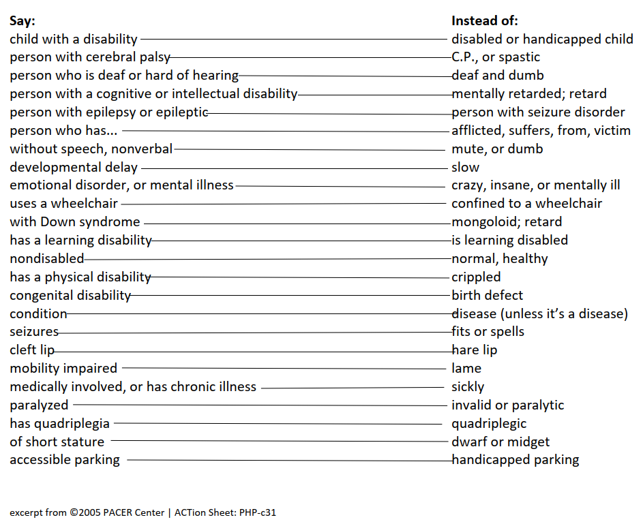
List of things to say regarding people with a disability

Slide 5
Why do parents have to do something at 18?
Everyone is presumed competent at the age of 18 until a judge determines otherwise.
What are some of the fears parents have regarding children with disabilities turning 18?
  Parents will no longer be able to make medical decisions or consent to treatment.
  My child may be exploited or taken advantage of in some way financially.
  No one will help my child or let me help them.
  I can no longer advocate for my child or protect them.
  I can no longer advocate for my child at school.
Notes:
These are some of the fears that parents and families have expressed to us about being able to continue to help their loved ones with disabilities after the age of 18.

Slide 6
How can we address those fears?
Notes:
Lots of options!

Slide 7
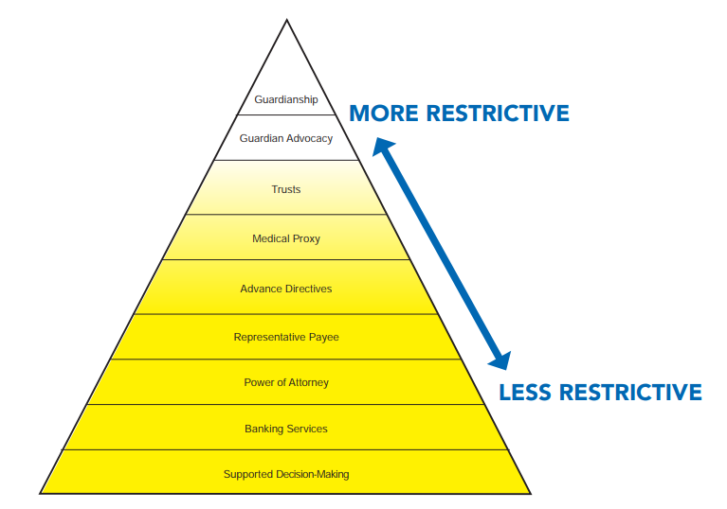
Pyramid of Most Restrictive to Least Restrictive
Florida Developmental Disabilities Council, Inc.
Notes:
Don’t assume guardianship or guardian advocacy is the only option!

Slide 8

Supported/Shared Decision Making

Slide 9
Supported/Shared Decision Making (SDM)
A tool that allows people with disabilities to retain their decision-making capacity by choosing supporters to help them make choices. A person using SDM selects trusted advisors, such as friends, family members, or professionals, to serve as supporters. (from the ACLU website)
The supporters agree to help the person with a disability understand, consider, and communicate decisions, giving the person with a disability the tools to make
informed decisions. (from the ACLU website)

Slide 10
Supported Decision Making in FL now:
Recently, SDM was adopted in the state of Florida, and pleadings in guardianship and guardian advocacy have changed to reflect that SDM has been considered and if it would not be a valid choice in each case.
Florida Statute § 709. 2209
Supported decision-making agreements.—
(1) For purposes of this section, “supported decision-making agreement”
means an agreement in which the power of attorney grants an agent the
authority to receive information and to communicate on behalf of the
principal without granting the agent the authority to bind or act on behalf
of the principal on any subject matter.
Notes:
Add the funky section symbol

Slide 11
Continuation of statute
(2) A supported decision-making agreement is not a durable power of attorney under s. 709.2104. Any language of durability in a supported decision-making agreement is of no effect.
(3) A supported decision-making agreement may only include the authority to:
  (a) Obtain information on behalf of the principal, including, but not limited to, protected health information under the Health Insurance Portability and Accountability Act of 1996, 42 U.S.C. s. 1320d, as amended; educational records under the Family Educational Rights and Privacy Act of 1974, 20 U.S.C. s. 1232g; or information protected under 42 U.S.C. s. 290dd-2 or 42 C.F.R. part 2.
  (b) Assist the principal in communicating with third parties, including conveying the principal’s communications, decisions, and directions to third parties on behalf of the principal.
(4) A communication made by the principal with the assistance of or through an agent under a supported decision-making agreement that is within the authority granted to the agent may be recognized as a communication of the principal.

Slide 12
Potential Problems with Supported/Shared Decision Making:
People, agencies, and asset holders may not be familiar with this concept.
It works until it doesn’t.
There could be a potential for fraud and undue influence, manipulation,
coercion, or other abuse.
This could be a boon for litigation.
Proceed with caution!

Slide 13
Where Can I Learn More About This?
  ACLU Disability Rights Program, www.aclu.org/disability
  National Resource Center for Supported Decision Making,
  www.supporteddecisionmaking.org
  Quality Trust for Individuals with Disabilities, www.dcqualitytrust.org
  Florida Developmental Disabilities Council, Inc. www.fddc.org
  Disability Rights Florida https://disabilityrightsflorida.org/disability-topics/disability_topic_info/what_is_supported_decision_making

Slide 14

Substituted Decision Making
Notes:
Explain the session format with a brief overview.
Send their questions in the chat feature and we will answer them as we can.
PP on our website and on the DSACF website too!

Slide 15
Durable Power of Attorney
Fla. Stat. § 709.2104
A power of attorney is a legal document delegating authority from one person to another. In the document, the maker of the power of attorney (the “principal”) grants another (the Agent) the right to act on their behalf. What authority is granted depends on the provisions of the power of attorney.
What are some uses of a power of attorney?( Fla. Stat. § 709.2201 Authority of agent/709.2208 Banks and other financial institutions)
A power of attorney may be used to give another the right to sell a car, home or other property. It might be used to allow another to access bank accounts, sign contracts, handle financial transactions or sign legal documents for the principal. A power of attorney may give another the right to do almost any legal act that the maker of the power of attorney could do, including the ability to create trusts and make gifts.
Must a person be competent to sign a power of attorney?(Fla. Stat. § 765.101 Definitions (11) Informed
consent ( Principal means competent adult/Fla. Stat. § 765.302(1) Procedure for making living
will “Any competent adult”)
Yes. The principal must understand the power of attorney document at the time it is signed.
The principal must understand the effect of a power of attorney, to whom the power of
attorney is being given, and what property may be affected by the power of attorney.
  (as explained in the Consumer Pamphlet, Florida Power of Attorney)
Notes:
Fla. Stat. §

Slide 16
Health Care Surrogate
Fla. Stat. § 765.101 Definitions (21) Surrogate/Fla. Stat. § 765.202 Designation of a health care surrogate)
A Health Care Surrogate is a legal document that names another person as the Principal’s representative to make medical decisions for the Principal if they cannot make such decisions for themselves. This can include specific instructions about any treatment the principal wants or does not want, similar to a living will. An alternate surrogate can also be designated.
Every competent adult has the right to make decisions concerning their
health, including the right to choose or refuse medical treatment.
Fla. Stat. § 765.102(1)
http://www.floridahealthfinder.gov/reports-guides/advance-directives.aspx

Slide 17
Can a Person With IDD Sign Advanced Directives in Florida?
Fla. Stat. § 393.12
(7) ADVANCE DIRECTIVES FOR HEALTH CARE AND DURABLE POWER OF ATTORNEY.—In each proceeding in which a guardian advocate is appointed under this section, the court shall determine whether the person with a developmental disability has executed any valid advance directive under chapter 765 or a durable power of attorney under chapter 709.
(a) If the person with a developmental disability has executed an advance directive or durable power of attorney, the court must consider and find whether the documents will sufficiently address the needs of the person with a developmental disability for whom the guardian advocate is sought. A guardian advocate may not be appointed if the court finds
that the advance directive or durable power of attorney provides an alternative to the
appointment of a guardian advocate which will sufficiently address the needs of the
person with a developmental disability.
Notes:
Just a reminder that individuals with IDD can sign DPOAs and HCS

Slide 18
Potential Challenges with Substituted Decision Making:
Neither the Durable Power of Attorney nor the Health Surrogate gives the Agent the right to make decisions against the will of the Principal. (Fla. Stat. § 765.105 Review of surrogate or proxy’s decision (1) (a) (d) and (e))
Examples:
If the Principal declines medical treatment, then the Agent cannot authorize
that treatment nor force the Principal to accept that medical treatment.
Further, if the Principal makes poor financial decisions, the Durable Power
of Attorney does not give the Agent the right to stop the Principal.

Slide 19
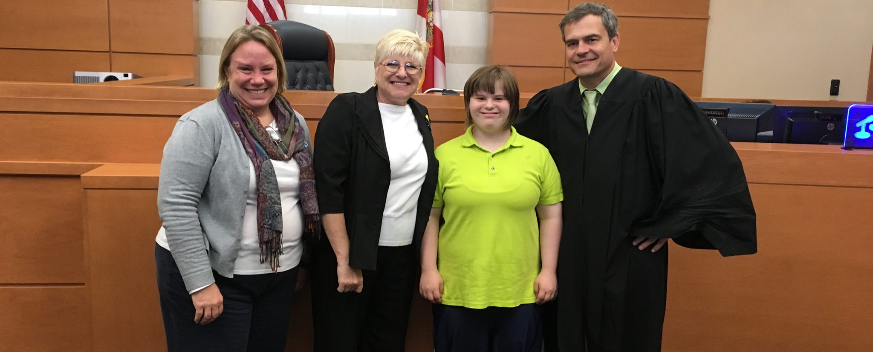
Guardian Advocacy

Slide 20
Guardian Advocacy generally:
Fla. Stat. § 393.12 provides a streamlined legal process where the court removes certain rights from the person with an intellectual or developmental disability (IDD) and appoints a Guardian Advocate to make specific decisions for that person.
A legal process with all of the oversight and control of the court for the lifetime of the person with IDD or until the rights removed are restored to that person.

Slide 21
Guardian Advocacy
Basis of Disability: Developmental Disability as defined in Fla. Stat. § 393.063(11)
Types: Person and/or Property
  Limited
  Plenary (ish)
Which rights can be taken away? Some, but not all (Fla. Stat. § 393.12 (2) (a) )
  Some circuits resolve by only taking away those that can be delegated
  vs. those that cannot.
Notes:
Basic elements for GA and walk through each step
How does their circuit address some but not all?
What is the benefit of looking past some but not all? What is the benefit of forcing people with IDD into a guardianship?

Slide 22
Guardian Advocacy rights cont.
Developmental Disability: (Fla. Stat. § 393.063(11)): a disorder or syndrome that is attributable to:
    Intellectual Disability
    Cerebral Palsy
    Autism
    Down syndrome
    Phelan-McDermid syndrome
    Prader-Willi syndrome
    Spina Bifida
    That constitutes a substantial handicap that can reasonably expected to
    continue indefinitely.
Notes:
Why just this group? What about everyone else? Me, I just include them in “intellectual disabiltiy

Slide 23
Guardian Advocacy cont.
Is an attorney required? (Fla. Stat. § 393.12(2)(b) Appointment of guardian advocate)
  If the person with IDD has property, the Petitioner/Guardian must have an attorney.
  If the person with IDD does not have property and the petitioner is seeking Gua Adv of the person only, the Petitioner/Guardian does not have to be represented by an attorney.
  During the Guardian Advocacy proceedings, the Court will appoint an attorney for the person with a developmental disability to ensure that
  his or her best interests are protected during the process.

Slide 24
All reports relevant to the person’s disability
While not required, the best practice is to file a letter/report from the treating physician that person with IDD: (Fla. Stat. § 393.12/Fla. Prob. R. 5.649)
  Has an Intellectual or Developmental Disability that manifested before the age of eighteen (Fla. Stat. § 393.063 (11)); and
  that the individual is unable to handle his/her affairs related to finances and physical well-being; and
  that he/she does need the assistance of a guardian advocate to meet the essential requirements for his/her physical health and/or safety.
  The report should mirror a typical Examining Committee report that identifies where the individual lacks the decision-making ability to do (list) and what they do have the decision-making ability to do (list).

Slide 25
All Reports Relevant to the Person’s Disability cont. Fla. Stat. § 393.12 (6) (d)
  However, you can also provide any of the following:
  All reports relevant to the person’s disability;
  Individual family or individual support plan;
  Individual education plan (IEP); or
  Other professional reports documenting the condition and needs of the person.

Slide 26
Delegable and Non-Delegable Rights
Fla. Stat. § 744.3215 (2-3) distinguishes two types of rights:
Non-Delegable | Delegable
To marry To vote To have a driver’s license To travel (without assistance or supervision) and To seek employment or retain employment. | To contract To sue and defend lawsuits To manage property or to make any gift or disposition of property To determine residence To consent to medical and mental health treatment; and To make decisions about social environment or other social aspects of life. To apply for government benefits
Notes:
This page needs to match the previous slide.

Slide 27
Rights Removed in Guardian of the
Person vs. Property
 | GUA of Person
Plenary | Remove the right: To vote To marry To have a driver’s license To travel To be employed To determine residence To consent to medical treatment To make social decisions.
Limited | Remove rights based on AIP’s abilities and situation
 | GUA of Property
Plenary | Remove the right: To contract To sue/defend lawsuits To apply for government benefits To manage property or to make any gift or disposition of property
Limited | Remove rights based on AIP’s abilities and situation.

Slide 28
Rights Retained in Guardian Advocacy and Guardianship Fla. Stat. § 744.3215(1)
Annual review of the guardianship report and plan;
To be restored to capacity at the earliest possible time;
To be treated humanely, with dignity and respect, and to be protected against abuse, neglect, and exploitation;
To have a qualified guardian (or guardian advocate);
To remain as independent as possible;
To be properly educated;
To receive visitors and communicate with others; and
To receive services and rehabilitation necessary to maximize their quality of life.
Notes:
Jeanne, add the others and put them in the proper order

Slide 29
Rights Removed in Guardian Advocacy
Typically, Orange County, Florida, for Gua-Adv of the Person, only removes/delegates the following:
To apply for government benefits;
To determine residency and to consent to residential placement;
To consent to medical and mental health treatment;
To make decisions about social environment/social aspects of life; and
To make decisions regarding education and educational and
vocational rehabilitation entitlements.
Note: This can change based on the preference of each circuit and/or judge.

Slide 30
What Does the Local Circuit Court Require:
Some but not all: What if the person with a disability clearly does not possess the ability to exercise any rights?
ABLE accounts: Does the local circuit court/judge require a Guardian Advocacy of the Property as well if the individual with IDD has an ABLE account?
Does the circuit/court require the guardian/guardian advocate to account for special needs trusts? What if the trustee is a corporate trustee?
How does the local judge treat a non-felonious criminal background for
the proposed Guardian Advocate? Or Bad credit?

Slide 31
Chapter 393
DEVELOPMENTAL DISABILITIES
2026 Florida Statutes
Title XXIX
PUBLIC HEALTH
Fla. Stat. § 393.12 Capacity; appointment of guardian advocate.—
(1) CAPACITY.—
(a) A person with a developmental disability may not be presumed incapacitated solely by reason of his or her acceptance in nonresidential services or admission to residential care and may not be denied the full exercise of all legal rights guaranteed to citizens of this state and of the United States.
(b) The determination of incapacity of a person with a developmental disability
and the appointment of a guardian must be conducted in a separate
proceeding according to the procedures and requirements of
chapter 744 and the Florida Probate Rules.
Notes:
REMINDER THERE IS NO ACTUAL DETERMINATION OF INCAPACITY

Slide 32
2026 Florida Statutes cont.
Fla. Stat. § 393.12 (2) APPOINTMENT OF A GUARDIAN ADVOCATE.—
(a) A circuit court may appoint a guardian advocate, without an adjudication of incapacity, for a person with developmental disabilities if the person lacks the decisionmaking ability to do some, but not all, of the decisionmaking tasks necessary to care for his or her person or property or if the person has voluntarily petitioned for the appointment of a guardian advocate. In determining whether to appoint a guardian advocate, the court shall consider the person’s unique needs and abilities, including, but not limited to, the person’s ability to independently exercise his or her rights with appropriate assistance, and may only delegate decisionmaking tasks that the person lacks the decisionmaking ability to exercise. Except as otherwise specified, the proceeding shall be governed by the Florida Rules of Probate Procedure.

Slide 33
STANDBY GUARDIANS
Fla. Stat. § 744.304 Standby guardianship.—(1) Upon a petition by the natural guardians or a guardian appointed under Fla. Stat. § 744.3021, the court may appoint a standby guardian of the person or property of a minor. The court may also appoint an alternate to the guardian to act if the standby guardian does not serve or ceases to serve after appointment. Notice of a hearing on the petition must be served on the parents, natural or adoptive, and on any guardian currently serving unless the notice is waived in writing by them or waived by the court for good cause shown.
(2) Upon petition of a currently serving guardian, a standby guardian of the person or property of an incapacitated person may be appointed by the court. Notice of the hearing shall be served on the ward’s next of kin.

Slide 34
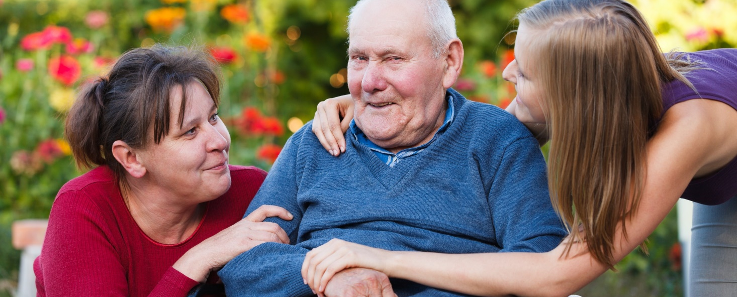
Guardianship

Slide 35
Guardianship Generally
Fla. Stat. § 744.3201 Petition to determine incapacity/Fla. Prob. R. 5.550 Petition to Determine Incapacity
Fla. Stat. § 744.331 Procedure to Determine Incapacity
Fla. Prob. R 5.560 Petition for Appointment of Guardian of an Incapacitated Person
Two legal proceedings:
  Incapacity: determination as to the level of capacity of the individual to manage their affairs with the assistance of an examining committee and a court-appointed attorney for the Alleged Incapacitated Person.
  Guardianship: legal proceeding where decision-making authority is delegated to another in the following areas:
    a. Person
    b. Property
    (Fla. Stat. § 744.3215 Rights of Persons Determined Incapacitated)

Slide 36
Guardianship Generally cont..
    Continues for the lifetime of the Ward or until their rights are restored by the court.
      (Fla. Stat. § 744.464 Restoration to Capacity/Fla. Prob R. 5.681 Restoration of Rights with Person of Developmental Disability/Fla. Prob. R. 5.680 Termination of Guardianship)

Slide 37
Guardianship Generally cont…
Basis: Incapacity for any reason, i.e., Alzheimer's, auto accident, minor child – Fla. Stat.
§ 744.
Types: Person (medical, social, etc.) and/or Property (assets, government benefits).
Rights removed: Any or all rights can be taken away from the Alleged Incapacitated Person (AIP)/Ward.
Attorneys: Both the Guardian and the AIP/Ward must be represented by
(separate) attorneys.
Requires the court’s determination of incapacity of the AIP.

Slide 38
Main Differences Between
Guardianship and Guardian Advocacy
Guardian Advocacy
Basis | Intellectual disability and/or developmental disability (FSS 393.063(11))
Type | Person and/or Property (if property, must have an attorney)
Rights removed | Some, but not all
Attorneys | Gua Adv need not have one, but the person with IDD will
Cost | $250 to $4,500 to establish
Incapacity | Letter from treating physician, etc.
Timing | 30-60 days
Guardianship
Basis | Incapacity for any reason (FSS 744.102(9))
Type | Person and/or Property
Rights Removed | Any or all rights can be removed
Attorneys | Both Guardian and AIP must have attorneys
Cost | $6,000 to $9,000 to establish
Incapacity | 3 member examining committee
Timing | 3-5 months

Slide 39

Guardianship or Guardian Advocacy?
Which is the right choice?
Notes:
You are likely here to discover what is right for their child. I hope to give you enough information to send you in the right direction with the information you need to be successful.

Slide 40
How Do Parents Decide What To Do?
Prior to the age of 18, everyone is presumed incompetent.
Over 18, everyone is presumed competent unless the court rules otherwise.
So, presume competency, but also know that they have to pick the least restrictive alternative that meets the needs of their loved one.
How do parents decide what is right for their loved one?
  https://www.stetson.edu/law/wings/
  Recommendation from treating physician and/or trusted partners,
  which may include teachers, therapists, et al.

Slide 41
How Do Parents Decide What To Do? Cont.
How strong is their understanding of an individual who may be non-verbal but can still make decisions for themselves and are fully competent?
Be the Light: Elizabeth Bonker’s 2022 Valedictorian Speech at Rollins College Commencement
https://www.youtube.com/watch?v=8g5aJExZQwg

Slide 42
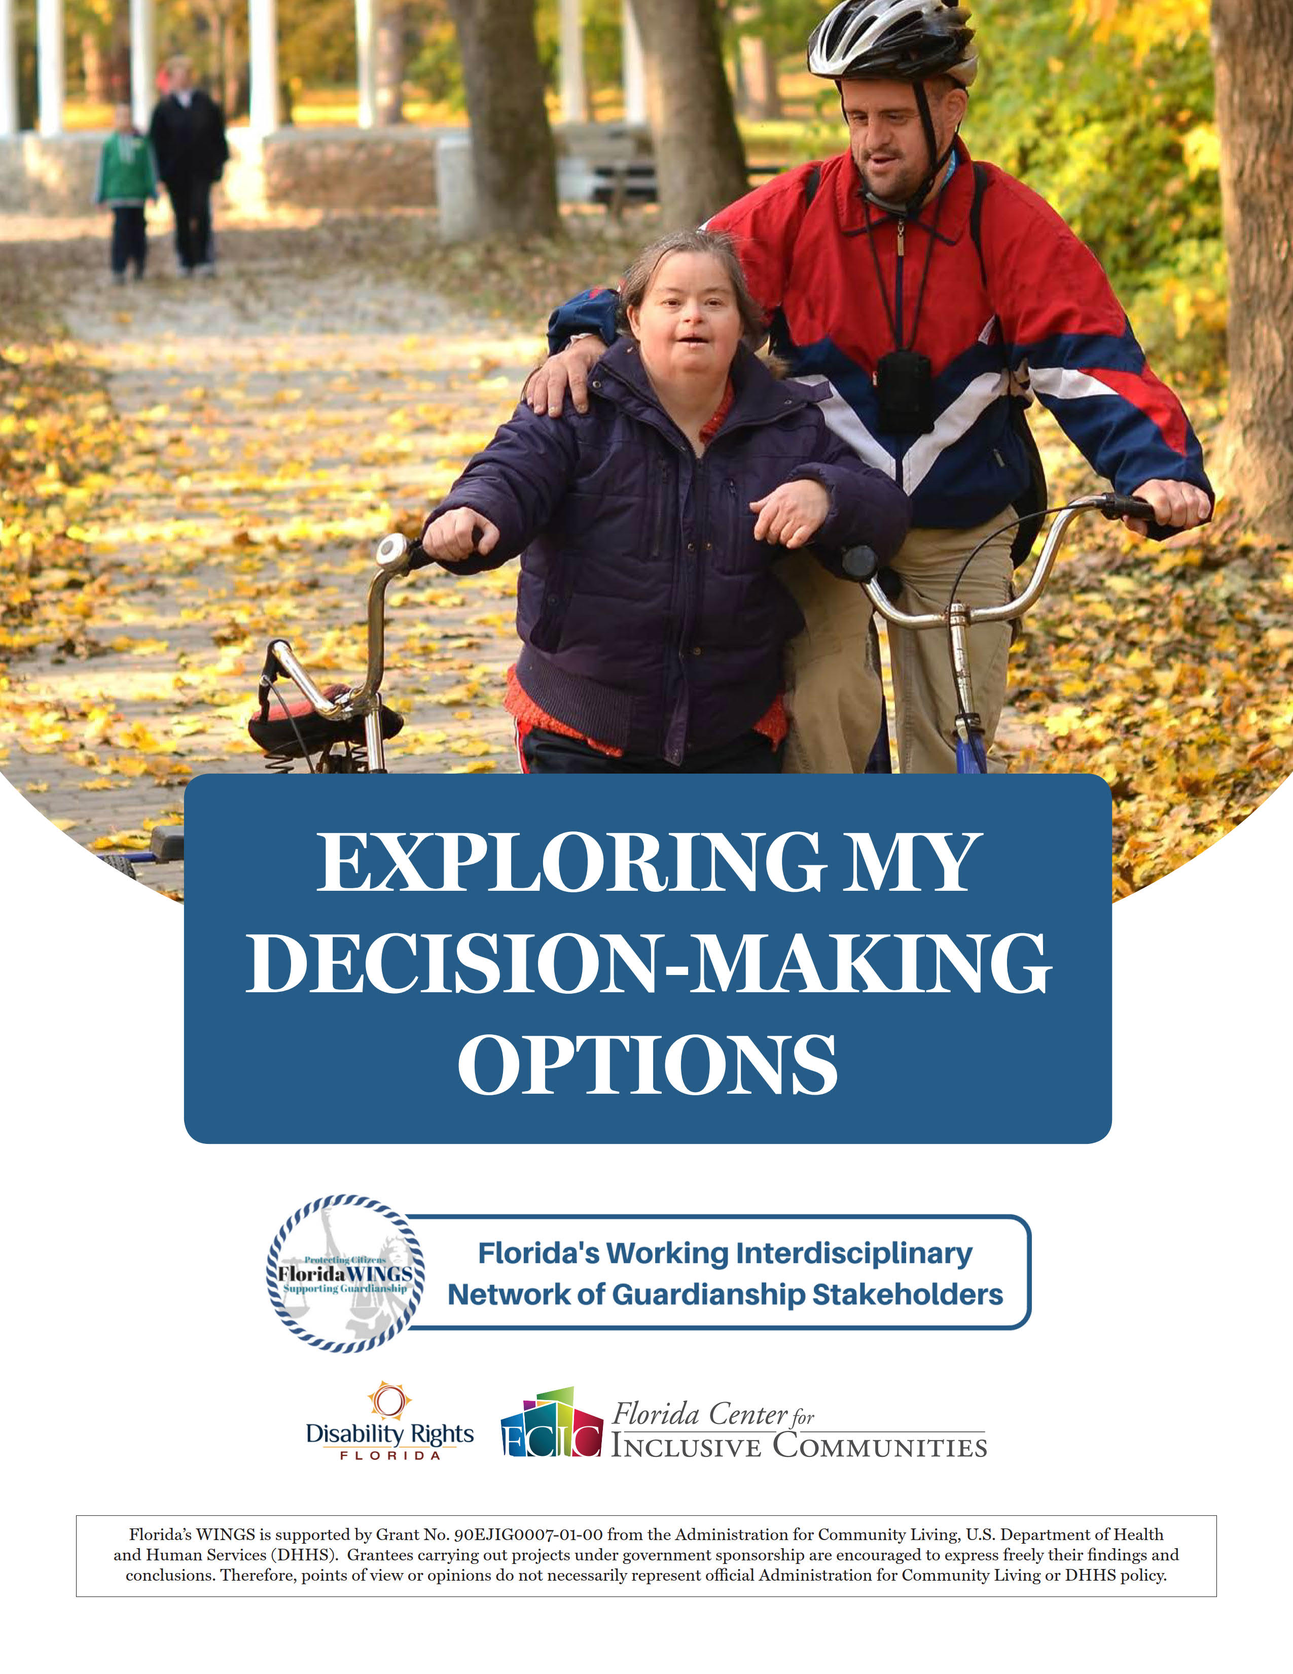
Exploring My Decision Making Options

Slide 43
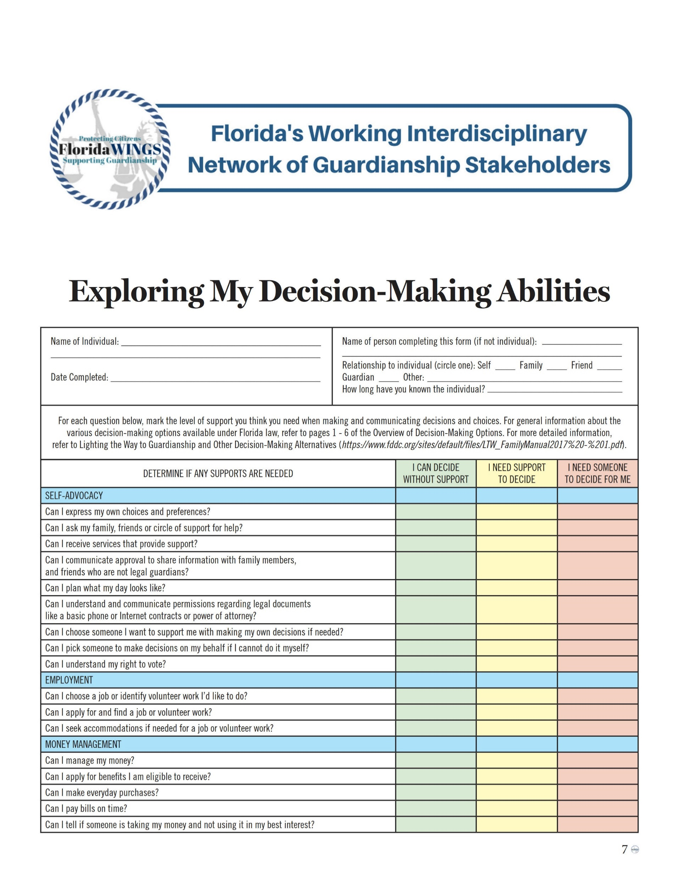
Exploring My Decision-Making Abilities

Slide 44
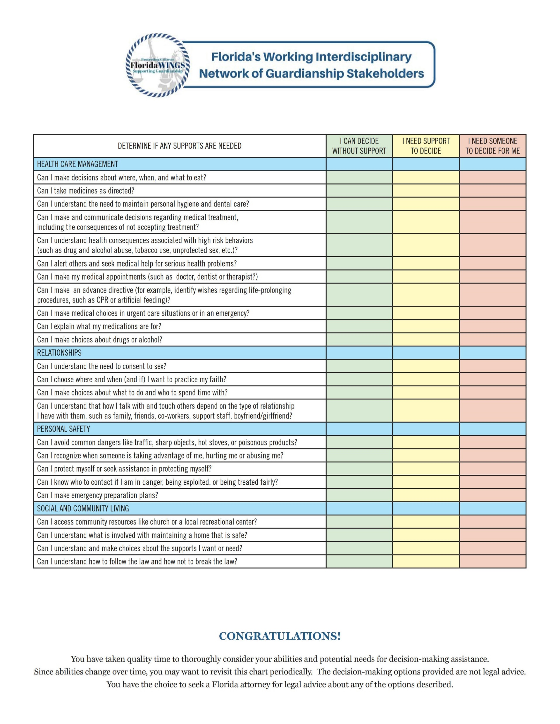
Exploring My Decision-Making Abilities cont.

Slide 45

What Are the Next Steps?
Notes:
Let them know what it means to work through the legal process on their own and what are the benefits to hiring an attorney. Give an example of what their firm does in regards to the three tiers of assistance. Point out that this gives them an idea when they are looking for an attorney if someone is reasonable or taking advantage of the situation. Let them know you have their cards and referral sheets.

Slide 46
Determine What is Right For Their Loved One With IDD
  If Supported/Shared Decision Making is the right choice for their family, do their research and be aware of how best to support their family member.
    “Lighting the Way to Guardianship and Other Decision-Making
    Alternatives A Manual for Individuals and Families” manual available
    online www.fddc.org
Notes:
IDD vs. DD

Slide 47
What is Right For Their Loved One?
  If Substituted Decision Making is best, then determine the need for the following:
    Power of Attorney, Health Care Surrogate, etc.
    Please encourage them to use a reputable attorney to prepare the documents.
      Use the list on our website of attorneys who volunteer for Low Down and/or
      Florida Bar Referral Service, https://www.floridabar.org/public/lrs/

Slide 48
What is right for their loved one? cont.
If Guardian Advocacy is best, consider the following:
  Can they work through the process independently using the materials available, including the step-by-step guide?
  Do they need an attorney to review the paperwork before submitting it to the clerk of the courts?
  Do they need an attorney to prepare the paperwork and guide them through the process, but they can do the rest independently?
  Do they need/ Would they prefer that an attorney handle the entire
  process for the family?
If Guardianship is best, then an attorney is required.

Slide 49
Guardian Advocacy Process
What does the process look like? (practically):
File the initial pleadings with the court to get started.
Fingerprints are done for the FDLE criminal background check.
Credit check is completed.
Notice to other family members is sent.
Court appointment of an attorney and elisor to represent the individual with IDD (chosen by the court or proposed by the family).
6. Hearing before the court on the petition, etc. (may be Zoom or
optional).

Slide 50
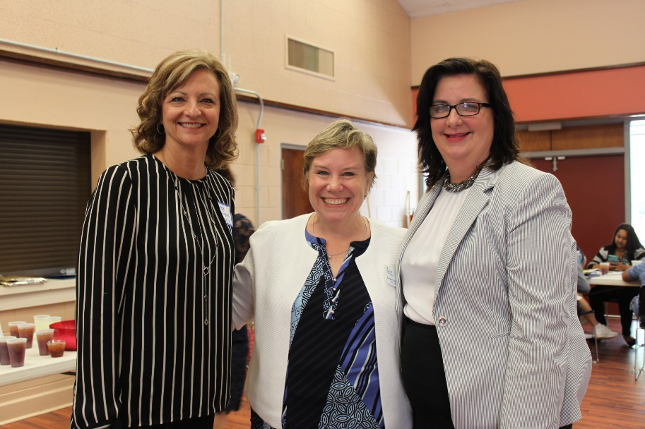
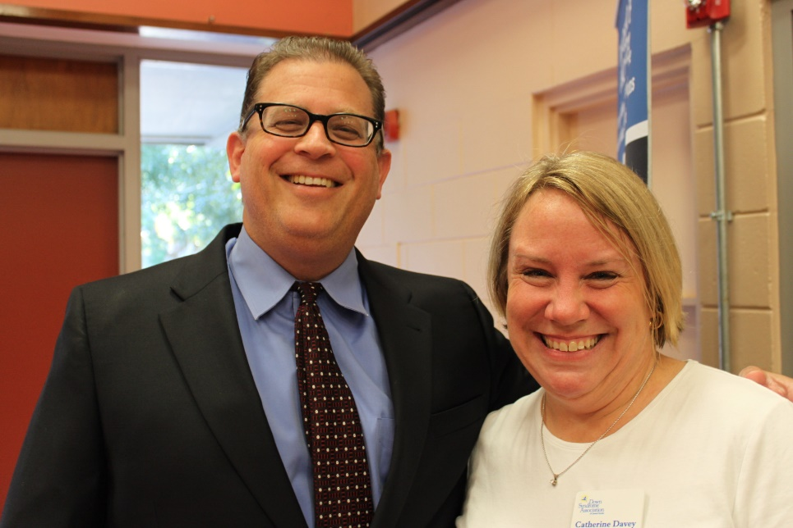
Moving Forward with a Guardian Advocacy
Judges Expectations

Slide 51
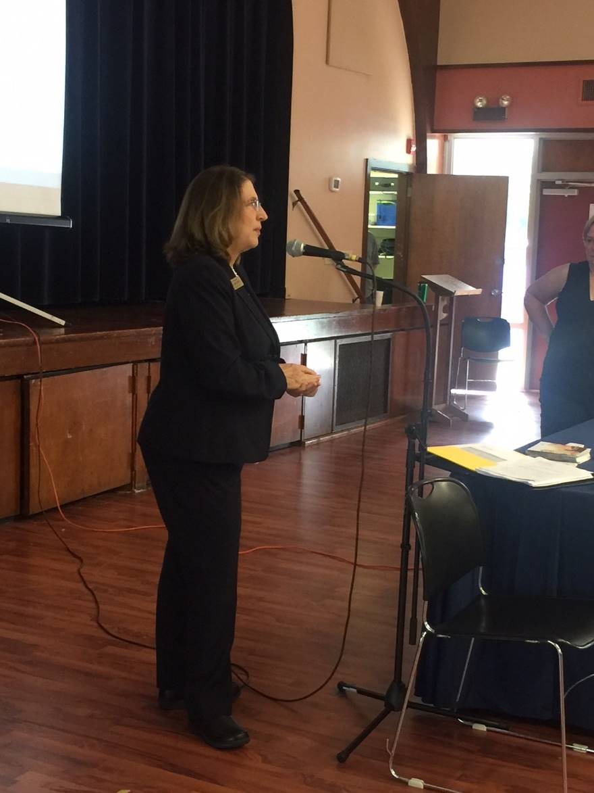
Questions Parents Have About the Courtroom
Do I really have to go to court?
What should I bring with me?
What is the judge going to say?
What if I forgot to do something?
Can they take my loved one away from me?
What if my family member is scared and does not want to come to court?
What are some things I should not do?
How long will the hearing take?

Slide 52
Guardian Advocacy (after appointment)
Once appointed as the Guardian Advocate, then you go to the duties and obligations that per Fla. Stat. § 393.12(10) are detailed in Chapter 744

Slide 53
Can they change their mind in the future?
Absolutely!
Guardian advocacy may be right for their family right now, but you may need to transition to guardianship in the future.
OR
What if their loved one continues to grow and mature and no longer needs help (or as much help)?
  What do you do?
  The Gua Adv/attorney/Protected Person files a Suggestion of Restoration
  of Rights, and the court appoints a doctor to examine the Ward.
  The court-appointed doctor then makes recommendations to the court
  about which rights can be restored to the Ward.

Slide 54
Do they have to be the Guardian Advocate forever?
What if the Guardian Advocate can’t or doesn’t want to be a Guardian/Advocate anymore?
  Stand By or Successor Guardian Advocates

Slide 55
Resources
Davey Law Group
https://www.daveylg.com/low-down-on-law/
Guardian Advocate Checklist- Brevard and Seminole
https://flcourts18.org/docs/bre/Guardian_Advocate_Checklist.pdf
Guardian Advocate Forms- Orange and Osceola
https://ninthcircuit.org/resources/court-forms/probate-guardian-advocate
Also available in part on the Thompson Reuters Westlaw Form Builder, Florida Guardianships, Local Forms, Ninth Circuit
Refer to Chapter on Guardian Advocacy in Florida Guardianship Practice, 12th edition
Notes:
Be cautious in using local forms to be sure they comply with the provisions of Fla. Statute section 393.12 and the Florida Probate Rules and have not randomly added other potentially offensive language: https://www.fljud13.org/Portals/0/Forms/pdfs/GA%20Forms%20packet.pdf
As a result, the Ward essentially functions at the grade level of ___ and all medical probability indicates that this condition will not change.

Slide 56
Resources cont.
WINGS Decision-Making Toolkit: https://www.stetson.edu/law/wings/media/decision-making-options-toolkit.pdf

Slide 57

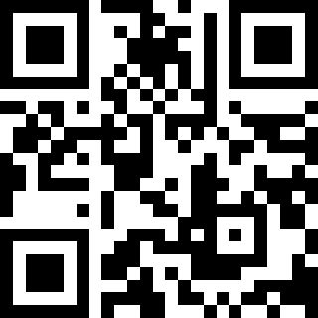
Thank You!
P.O. Box 941251
Maitland, FL 32794-1251
Phone: (407) 645-4833
Fax: (407) 645-4832
www.DaveyLG.com
Use the QR code to learn more
Notes:
Take questions or let them know they can come to the table to speak with you further.

