Slide 1
You have a Special Needs Trust, now what?
Catherine E. Davey, JD, LLM
Davey Law Group, P.A.
Richard La Belle, Esq. Family Network on Disabilities
Disclaimer: This presentation is intended for educational purposes only and does not constitute legal advice. Catherine Davey is not acting as your attorney and does not represent you in any legal capacity.
Notes:
Florida Prepaid College Board: Created to provide Florida families with an affordable means to save for their children’s future college education, the Florida Legislature created the Florida Prepaid College Program in 1987. The first Florida Prepaid College Plans were sold in 1988, and were augmented with the addition of the Florida 529 Savings Plan in 2002. Over $10 billion invested in program. ABLE United is newest program.

Slide 2

The Why
Notes:
Now that we’ve talked about some of the key benefits of ABLE United, let’s discuss who can open an account.

Slide 3
What is a Special Needs Trust?
A type of trust that allows an individual who is/would be determined to be disabled according to Social Security’s guidelines to have the benefit/use of the funds held in the trust to improve their quality of life during their lifetime, in addition to their government benefits.
42 USC 1396p(d)(4)(a), et seq.

Slide 4
What is the Purpose of a Special Needs Trust?
Maximize resources received for an individual with disabilities and improve their quality of life (1993 OBRA Act).
Protect federal and state means-tested (needs-based) public benefits.
“Support and Health” vs. “Comfort and Happiness.”
Supplement, not supplant (get everything you can from government benefits first and then go to the SNT, etc.)
Receive and administer assets for the sole/primary benefit of the individual.

Slide 5
Who can have a SNT?
Does the person have a disability?
If yes, then yes!
If no, then no.
Notes:
5

Slide 6
How is “disabled” defined?
Disabled as defined in 42 USC 1382c(a)(3)
(3)(A) An individual shall be considered to be disabled for purposes of this subchapter if he is unable to engage in any substantial gainful activity by reason of any medically determinable physical or mental impairment which can be expected to result in death or which has lasted or can be expected to last for a continuous period of not less than twelve months (or, in the case of an individual under the age of 18, if he suffers from any medically determinable physical or mental impairment of comparable severity).
Notes:
6

Slide 7

Notes:
7

Slide 8
Types of Special Needs Trusts
Ask the question: Whose funds are these?
Third-Party: someone other than the beneficiary or spouse.
Self-Settled or First-Party: with beneficiary’s own funds.
Stand Alone
Pooled SNT
Notes:
8

Slide 9
Comparing Third-Party and First-Party SNTs
 | Third Party |  | Self Settled
Whose Money? | Family, Friend, Other |  | The Person with the Disability
Revocable? | Yes |  | No
How Used?
Medicaid Payback? | No |  | Yes
Who can be Grantors? |  |  | Parent, Grandparent, Guardian, Court or Person with the Disability
Notes:
9

Slide 10
Third-Party Special Needs Trusts
Whose money? Funds do not belong to the person with a disability.
It is created/established up by a family member or friend for a person with disabilities.
What type of document?
Stand-alone Third Party-SNT
Testamentary SNT; or
Contingent Beneficiary Third Party-SNT provisions
After the Beneficiary’s lifetime, no Medicaid payback.
Grantor decides where the funds go.
Notes:
10

Slide 11
How much should I put into the Third-Party Special Needs Trusts for my loved one?
Yes.
However much you can.
The needs will likely always exceed the amount in the trust (part of the reason, we need the government benefits too).
Notes:
11

Slide 12
First-Party (self-settled) Special Needs Trusts
Medicaid payback is required after the lifetime of the beneficiary.
Trust must be Irrevocable (with caveats that it could be changed by court for very limited reasons).
Person with a disability must be under the age of 65.
Must be the funds of the person with a disability.
Inheritance
Personal Injury Award
Earnings and Savings
After the beneficiary’s lifetime, debt to Medicaid paid.
Notes:
12

Slide 13
First-Party Special Needs Trusts
Who can be the Grantor?
Parent
Grandparent
Guardian (upon court approval)
Court; or
Person with a Disability
Notes:
13

Slide 14
Who is/Should be the Trustee?
Especially for SNTs, I generally DO NOT recommend that well-intentioned family members or friends act as Trustees. These trusts are very complicated, with many duties for the Trustee including:
Understanding of Medicaid eligibility and spending rules.
Investing
Tax Filings; and
Annual Accountings to DCF, SSA, and even potentially the remaindermen.
This is the time for a corporate trustee who is well versed in managing SNTs.
Notes:
14

Slide 15
Pooled Trusts (D4C SNT)
By combining funds with others similarly situated (pooling), administrative costs and trustee fees can be lowered, and “minimum fees” can be avoided.
Some pooled trusts have one-time enrollment fees as low as $500.
Many pooled trusts do not have minimum monthly or annual fees.
Non-profit organizations also administer trusts.
Requires signing a Joinder Agreement.

Slide 16

Third-Party Special Needs Trusts
Notes:
16

Slide 17
How Does it Work Practically?
The Trust will not pay cash to the beneficiary.
Trustee distributes directly to third-party vendors (doctors, therapists, contractors, etc.) NOT to the person with a disability.
Why? If paid to them directly, SS/DCF would treat those funds as income to the person with a disability and disqualify them based on being over income (remember their benefits are typically both income and asset based) .
Tru Link card: funded by the SNT for expenses of the person with a disability (trulinkfinancial.com).
Notes:
17

Slide 18
Who benefits from the SNT?
Sole benefit or primary benefit is the person with a disability (not a whole family and/or friends, etc.)
Example:
Can it pay for a caregiver to accompany the person to Disney? Yes.
Will it pay for 12 people to accompany the person? No.
Notes:
18

Slide 19
What are Some of the Expenses That a SNT Can Pay?
Home renovations generally, and to accommodate the disability of the beneficiary.
Rental expenses and/or taxes and maintenance on the home.
Supplemental medical and dental expenses (not covered or paid for by Medicare/Medicaid).
Purchase medical insurance (you can buy better insurance).
Quality of life items, including electronic equipment (very broad: mobile and land-based phones, computer, iPad, laptop, television, streaming services), etc.
Care Manager, Residential Caregiver (compensation and expenses).
Regular contact with the beneficiary for family members.
Notes:
19

Slide 20
Annual evaluation of needs
Their physical condition.
Educational, residential, vocational, and training opportunities.
Recreational, leisure, and social needs.
Appropriateness of existing program services.
Laws and administrative practices relating to various public benefit programs, because the Beneficiary may not have a reasonable chance of earning sufficient income to support himself, so it is essential that these benefits be secured.
Legal rights, treatment in accord with his needs, payment of a fair wage for work performed, and, if deemed to have the capacity, the right to vote and to marry.

Slide 21
What else can a SNT Can Pay?
Life insurance on the caregiver.
Vacations (including non-refundable airline tickets), cultural events, concerts, and sporting events.
Vehicle (including insurance, maintenance, etc.)
Professional expenses (lawyers, CPAs, etc.)
Tax payments.
Anything to improve the quality of life of the person with a disability?
Semi-private or private rooms.
Subscriptions to magazines, newspapers, etc.
Preneed funeral plan.
IF THE PERSON IS NOT ON SSI, the SNT can directly pay for food and shelter (rent, etc.) expenses.
Notes:
21

Slide 22
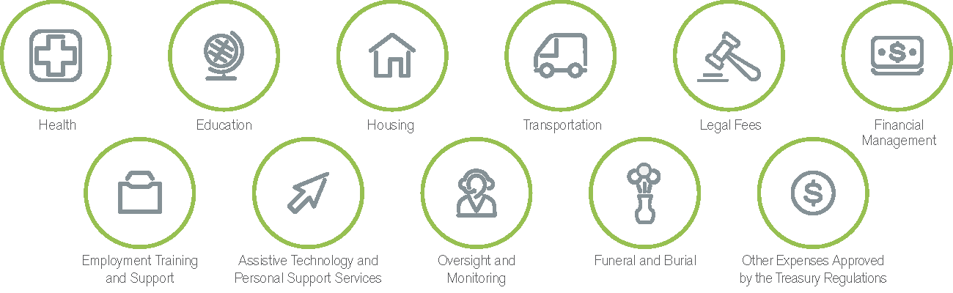
Qualified Disability Expenses (ABLE)
Relates to disability and maintains/improves health, independence, or quality of life
Qualified disability expenses, including “living expenses,” are not required to be medically necessary or to be limited for the sole benefit of the individual with a disability.
Notes:
Relates to the persons disability. Example from US treasury of cell phone

Slide 23
What Are Some of the Expenses That a SNT Cannot/Should Not Pay/Do?
Anything that government benefits can/should pay FIRST!
Again, not cash, gifts cards or gift certificates to the person with a disability.
Payments of rent/mortgage, property taxes, homeowners’ insurance, utilities, food, clothing, etc.
Payment of these expenses can be treated as income to the person with a disability and therefore, at best, reduce their monthly SSI distributions and, in the worst case, eliminate their eligibility to Medicaid and other programs that may be critical for their long-term care . If they are not on SSI or means-tested benefits, the rules are different.
Credit card bills of the person with a disability.
Lottery tickets, diamond jewelry?? No.
Beneficiary with a disability can never be the Trustee
Notes:
23

Slide 24
How Does an ABLE Account Work With an SNT?
ABLE can do things that SNTs cannot and vice versa:
If the SNT pays into an ABLE account which then pays rent for the person with a disability (and the funds are used within the same calendar month), then the distribution for support and/or health would not reduce the monthly SSI payment as it is not treated as income for SS benefit purposes.
Notes:
24

Slide 25

Notes:
25

Slide 26
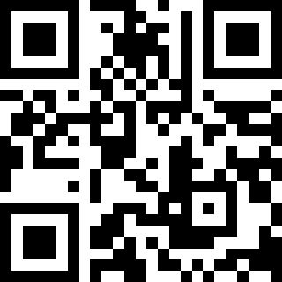
Questions
Visit www.DaveyLG.com for more information about Davey Law Group, P.A.
407-645-4483 (Monday-Friday: 8:30 am – 5 pm)
Email: reception@daveylg.com
Visit www.fndtrustservices.org for more information about FND Trust Services
727-291-8046
Fndtrustservices.org/contact-us/
Thank You!
Use the QR code to learn more about the Davey Law Group, P.A.
Notes:
Common questions: difference between ABLE account and special needs trust? Talk about hand out
Do I have to file taxes? Tax reporting: 5498qa to IRS stating able contributions, rollover contributions, cumulative contributions, fair market value, if able account was opened this year, basis of eligibility :SSDI, SSI, or disability certified and finally primary disability type: developmental, intellectual, psychiatric, nervous, congenital anomalies, respiratory or other
1099QA if you have a withdrawal showing amount of withdrawal, how much was earnings, only report if you had non qualified disability expenses.

